Slide 1
PRINCE2 Agile® Foundation course
How to use PRINCE2® with agile ways of working
PRINCE2 and PRINCE2 Agile are registered trade marks of Axelos Limited, used under permission of Axelos Limited. All rights reserved.
This course is based on Axelos PRINCE2 Agile materials. Material is used under license from Axelos Limited. All rights reserved.
Parts of this work are copyright © Aspire Australasia Pty Ltd 2021-2022.

Slide 2
Welcome
PRINCE2 and PRINCE2 Agile are registered trade marks of Axelos Limited, used under permission of Axelos Limited. All rights reserved.

Slide 3
About yourself
Name (and company)
Role
Experience of PRINCE2
Experience of agile
Your objective for this course
Something interesting about yourself
PRINCE2 and PRINCE2 Agile are registered trade marks of Axelos Limited, used under permission of Axelos Limited. All rights reserved.
Notes:
Trainer to show this slide, ask each delegate to prepare to introduce themselves to the group.
Then the trainer should introduce themselves, to give delegates time to gather their thoughts.
Then the trainer asks a delegate to start delegate introductions.
It is very likely that there will be a wide variety of experiences amongst the delegates therefore people should be put at ease if they have very little knowledge in certain areas.
Perhaps ask how many people have used a method called ‘winging it’ or the ‘Nike method’ i.e. just do it

Slide 4
COURSE OBJECTIVES
Understand the key aspects of PRINCE2
Understand basic concepts behind common agile ways of working
Demonstrate the purpose of combining PRINCE2 with agile ways of working
Be able to fix and flex the six aspects of a project in an agile context
Apply the PRINCE2 principles and tailor the themes, processes and management products to a project in an agile context
Incorporate the focus areas that can support a PRINCE2 Agile implementation
Prepare for the PRINCE2 Agile Foundation Exam
PRINCE2 and PRINCE2 Agile are registered trade marks of Axelos Limited, used under permission of Axelos Limited. All rights reserved.

Slide 5
About the PRINCE2 AGILE manual
Aligned to the PRINCE2 2017 manual (released in mid-2018)
Early chapters
Basic understandings and drivers for PRINCE2 Agile.
Middle chapters
Discussion and description of the principles, themes, processes and management products
What you may find
What to do.
Final chapters
Focus areas: where PRINCE2 needs more detailed guidance when in an agile context
The appendices.
PRINCE2 and PRINCE2 Agile are registered trade marks of Axelos Limited, used under permission of Axelos Limited. All rights reserved.
Notes:
Updated to take into account the name changes for PRINCE2 2017
Note this version of PRINCE2 Agile does not address the new sections in the PRINCE2 2017 manual, e.g. minimum requirements.
Points out that the PRINCE2 Agile manual is deliberately split into three sections. The reason for this is that section 1 is needed to create a baseline of understanding about what agile is and what PRINCE2 Agile is. Section 2 is the main body of the manual where PRINCE2 is tailored to operate in an agile environment, and section 3 contains specific areas of information that is needed to provide more detail where PRINCE2 only provides basic information which is not really enough when needing to work in an agile context.

Slide 6
Course structure
Part 1 – Introducing PRINCE2 and agile
Introducing ‘agile’
Introducing PRINCE2
Agile ways of working
Part 2 – Combining PRINCE2 and agile ways of working
Agile behaviours and PRINCE2’s principles
Agile and PRINCE2’s themes
Agile and PRINCE2’s processes
Part 3
PRINCE2’s Focus Areas
PRINCE2 and PRINCE2 Agile are registered trade marks of Axelos Limited, used under permission of Axelos Limited. All rights reserved.

Slide 7
Foundation exam structure
1 hour exam
Closed book
50 questions each worth 1 mark
Pass is 55% or 28 marks
Question types
Standard
Negative
List
PRINCE2 and PRINCE2 Agile are registered trade marks of Axelos Limited, used under permission of Axelos Limited. All rights reserved.
Notes:
When the exam is taken will differ depending on the training provider

Slide 8
Part 1 INTRODUCING PRINCE2 AND AGILE
PRINCE2 and PRINCE2 Agile are registered trade marks of Axelos Limited, used under permission of Axelos Limited. All rights reserved.

Slide 9
Introducing ‘agile’
PRINCE2 and PRINCE2 Agile are registered trade marks of Axelos Limited, used under permission of Axelos Limited. All rights reserved.

Slide 10
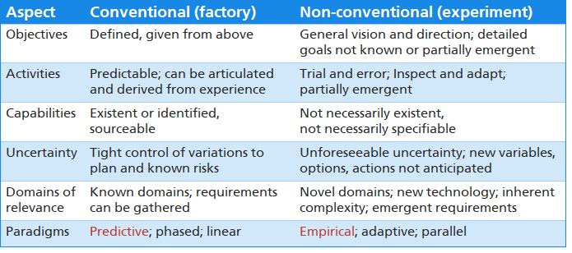
Project DOmains
Copyright © Aspire Australasia Pty Ltd 2021-2022.
Notes:
Let’s start by thinking about the sorts of projects that might benefit from agile ways of working.
We’ll compare and contrast the approaches to a conventional project such as the construction of a new railway line, that’s been done many times before, with a non-conventional project such as the development of a new product integrating novel processes and technologies for the first time.
The more conventional project can be said to be far less risky than the non-conventional project, which allows a more linear approach to planning and control. The overall management and control paradigm should be predictive, based on experience and lessons gained from many previous projects of the same type. I like to think of this domain as being like setting up a routine batch run in a factory, or as applying an engineering approach to projects.
The non-conventional project will have many aspects that are emergent, meaning that to a high degree the project could be regarded as a learning environment. As such, the overall management and control paradigm should be empirical, incorporating small steps, with inspection and adaptation at the end of each step. This approach is generally considered to be ‘agile’. I like to think of this domain as being like running an experiment, or like using the scientific approach to rapidly learn about the novel aspects of the project.
Applying an agile approach to a conventional project would probably not generate much value, and would certainly not leverage the advantages available in a predictable situation. Conversely, applying a predictive approach to a non-conventional project will likely cause the project to get into trouble, because you’d be relying on too many assumptions.
One of the roles of a project manager is to ensure that an appropriate approach is selected for each of their projects. Of course, many projects have some aspects that could be treated in an agile way, and other aspects that could be treated in a more conventional way, so that these projects could benefit from a hybrid approach.

Slide 11
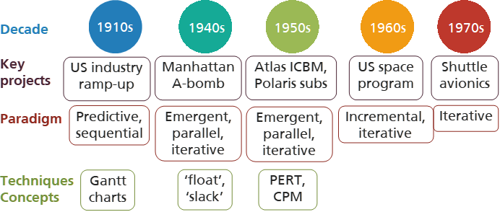
Approaches to new product development 1
Now associated with ‘agile’
Copyright © 2012 Geoff Rankins. Extract from a presentation on “Non-traditional Project Management” at AIPM National Conference 2012
Notes:
Let’s detour for a moment to review the evolution of project management and approaches to new product development, focusing on techniques that are now associated with ‘agile’.
Projects before the 1940s used a predictive paradigm and sequential activities. These projects were usually lead by the lead architect or lead engineer; the role of project manager did not exist.
Most conventional projects today use graphical charts to show the project’s schedule of activities. An American engineer Henry Gantt developed simple versions of these charts around 1909, and used an improved version to help the US ramp up industrial production prior to its entry into World War 1. Similar charts were developed and used by Hermann Schürch for an innovative bridge construction project in Switzerland in 1912. The charts were first called Gantt charts in a book published in 1922.
In the 1940s, during World War 2, the Manhattan project was established to create the first atomic bombs. Because of the significant unknowns associated with the project, and its urgency, a conventional predictive approach would have been too risky. Instead, the project used approaches such as emergent detail, parallel workstreams and iterative development. In the same timeframe, some advances in project scheduling techniques were developed. For example, in the Pacific war the US Navy needed to ensure that all of the ships in a fleet arrived at the target island at the same time. So, faster ships were ordered to ‘float’ for a time, to allow slower ships time to catch up. The US Army used the same concept, but called it ‘slack’ instead.
In the 1950s various projects, such as the creation of the first Intercontinental Ballistic Missiles and submarine-launched missiles, used the same paradigms as the Manhattan project to deal with their unknowns.
In this timeframe, several techniques were developed to improve the control of schedules.The Program Evaluation and Review Technique (or PERT) was developed as a variation of a Gantt chart. And the Critical Path Method (or CPM) allowed project managers to calculate the shortest possible sequence through a complex set of interrelated activities, to determine minimum project length and identify which activities needed special attention. These techniques are now embedded in common scheduling tools.
In the 1960s, the US space program, which culminated in the Apollo moon landings, used paradigms such as incremental development of capability and iterative development of components.
In the 1970s, the development of the avionics system for the Space Shuttle was accomplished in 6 iterations.
Many of these paradigms, developed for use with non-conventional projects over the last 80 years, are now associated with with what we call ‘agile’ projects.

Slide 12
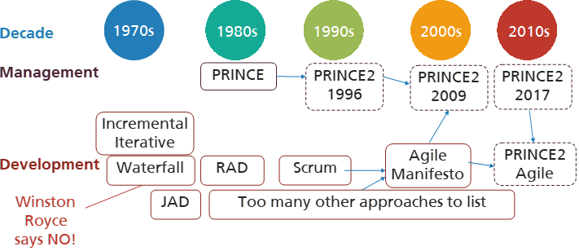
Approaches to new product development 2
Copyright © 2012 Geoff Rankins. Extract from a presentation on “Non-traditional Project Management” at AIPM National Conference 2012
Notes:
This is the second slide of a highly selective history of projects over the last 80 years, that illustrates that many of the concepts now called ‘agile’ have been in use for a very long time.

Slide 13
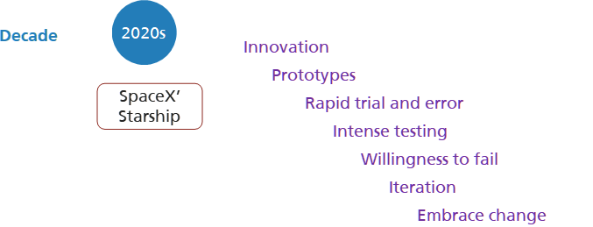
Approaches to new product development 3
Copyright © Aspire Australasia Pty Ltd 2021-2022.
Notes:
Probably the most widely known use of agile approaches in the 2020s (so far) is the development of SpaceX’ Starship.
Elon Musk was seen as a figure of ridicule in the space industry for almost 20 years, but he is now considered to be the most innovative participant.
The way SpaceX got to this point so quickly was by blowing up a lot of prototypes as part of an aggressive trial-and-error program.
According to Musk, an intense testing regime was the quickest way to refine the engineering and manufacture of the rockets.
Musk believes that, historically, an unwillingness to risk failure hampered improvements in NASA's Space Shuttle program.
“Lack of iteration was a problem because there were a lot of issues they were aware of, but people were too afraid to make change," he said.

Slide 14
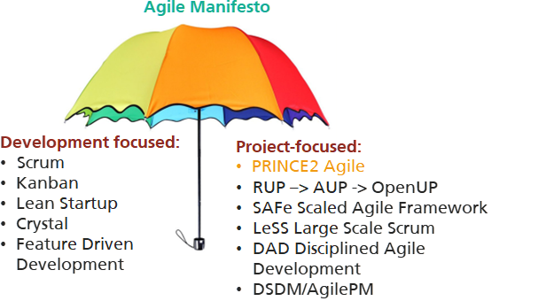
Agile Approaches
PRINCE2 and PRINCE2 Agile are registered trade marks of Axelos Limited, used under permission of Axelos Limited. All rights reserved.
Notes:
Today, there are a large number of approaches which position themselves under the agile ‘umbrella’.
Many of these approaches are product development focused. This course will briefly introduce Scrum, Kanban and Lean Startup, because they work well with PRINCE2 Agile, but will otherwise not cover any of the other techniques.
There are also a number of agile methods or frameworks that are more project focused, or which help organisations scale up agile product development techniques to address larger projects.
PRINCE2 is a general project management method, which is easily tailored to incorporate agile methods such as Scrum, Kanban and Lean Startup. This course is specifically concerned with the agile extension to PRINCE2.
This course will not address any of the other project-focused approaches, nor will it look at any of the software tools that many agile teams use.
In 2001, representatives of a number of the approaches shown here met, and came up with the word ‘agile’ as a collective brand, and developed what they called the Agile Manifesto, which is a set of value statements describing the commmonalities between their approaches.

Slide 15
The Agile Manifesto
PRINCE2 and PRINCE2 Agile are registered trade marks of Axelos Limited, used under permission of Axelos Limited. All rights reserved.
Notes:
And here is the Agile Manifesto. Notice its focus on software development. For the purposes of this course, we’ll replace the word ‘software’ with the more general word ‘product’, because agile ways of working can be used to develop many different types of novel products.
The Agile Manifesto presented four foundational value statements.
The first value in the Agile Manifesto is “Individuals and interactions over processes and tools.” Valuing people more highly than processes or tools is easy to understand because it is people who respond to business needs and drive the development process. If the process or the tools drive development, the team may be less responsive to change and less likely to meet customer needs. Communication is an example of the difference between valuing individuals versus process. If the focus is on individuals, communication is fluid and happens when a need arises. If the focus is on process, communication is scheduled and requires specific content, which may not be of value to anyone.
In conventional projects, enormous amounts of time are spent in documenting the products to be developed. These documents include business and technical requirements, technical architectures, technical specifications, interface design documents, delivery plans, test plans, and so on. The list is extensive and is a cause of the long delays in development. Agile does not eliminate documentation, but it streamlines it in a form that gives the developer what is needed to do the work, without getting bogged down in detail. The Agile Manifesto values documentation, but it values working products more.
Contract negotiation occurs when the customer and supplier work out the details of a delivery in advance, perhaps with points along the way where these details may be renegotiated. With waterfall development models, customers negotiate the requirements for the product, often in great detail, prior to any work starting. This mean the customer is involved in the process before development begin sand later after it is completed, but not so much during development. Collaboration is a different creature entirely. The Agile Manifesto describes a customer who is engaged and collaborates throughout the development process. This makes it far easier for developers to meet the needs of the customer, because they can resolve any uncertainties rapidly. Agile methods may include the customer at intervals for periodic demos, but a project could just as easily have an end-user representative embedded as part of the team and attending all meetings, ensuring the product meets the business needs of the customer.
Because of the great early investment in documentation and contract negotiation made by conventional projects, they may regard the rework necessitated by change as an expense, that is to be avoided if possible. With agile ways of working, the avoidance of such heavy upfront investment, and the shortness of each development cycle, means that priorities can be shifted from iteration to iteration, and new features can be added into the next iteration. Agile’s view is that changes always improve a project; changes provide an opportunity to generate additional business value.
A problem was initially created when people interpreted the Agile Manifesto as saying that the elements to the right of the four value statements were to be avoided. A better view is that while the elements to the left of each value statement reflect the preferred way of working, the elements to the right, while deferred or less important, could still be important if applied in such a way as to support the intent of the Manifesto. For example, tools will be useful to support agile teams which are not co-located, but these tools should not be allowed to drive the behaviour of the teams.
The Agile Manifesto is supported by 12 principles of agile development. To avoid confusion, we will not cover these principles in this course, because PRINCE2 comes with its own set of principles.
Despite being 20 years old, the Agile Manifesto probably remains the best definition of ‘agile’.

Slide 16
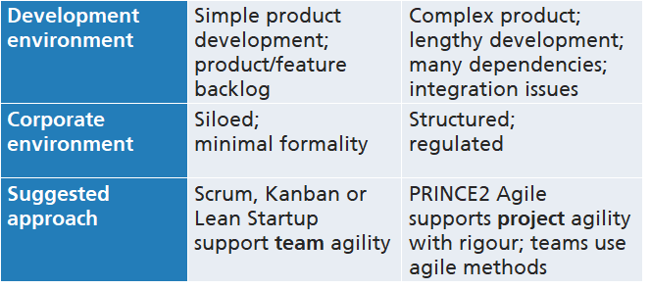
Which agile approach?
Copyright © Aspire Australasia Pty Ltd 2021-2022.
Notes:
An agile approach may not be right for every project. The selection of an approach, and the tailoring of that approach to suit the needs of the project or team, are in fact features of agile.
It may be that for simple product development in an environment which does not demand a lot of formality, one of the product development focused techniques such as Scrum or Kanban may be adequate in itself at team level.
However, as the complexity of the project increases, and as the project’s environment becomes more demanding, a more robust, project-focused technique may be required at project level.
PRINCE2 Agile supports project agility with an appropriate and tailorable degree of rigour. Teams within the project can continue to use Scrum, Kanban or whichever other agile techniques they decide to use.

Slide 17
Project or BAU
PRINCE2 and PRINCE2 Agile are only suitable for projects
Agile can be used on projects and for ongoing ‘Business as Usual’ (BAU) work
It’s important to understand the difference between projects and BAU to use agile appropriately
Based on Axelos PRINCE2 Agile materials. Material is used under license from Axelos Limited. All rights reserved.
PRINCE2 and PRINCE2 Agile are registered trade marks of Axelos Limited, used under permission of Axelos Limited. All rights reserved.
Notes:
It is critical from the outset to ensure that every delegate understands the difference between project work and BAU work.
Most of what is said and written about agile refers to BAU but PRINCE2 Agile does not operate in a BAU environment. The point of PRINCE2 Agile is to run projects in an agile context and it is therefore the application of agile ways of working (that work well in a BAU context) in a project context. This is what PRINCE2 Agile seeks to achieve.

Slide 18
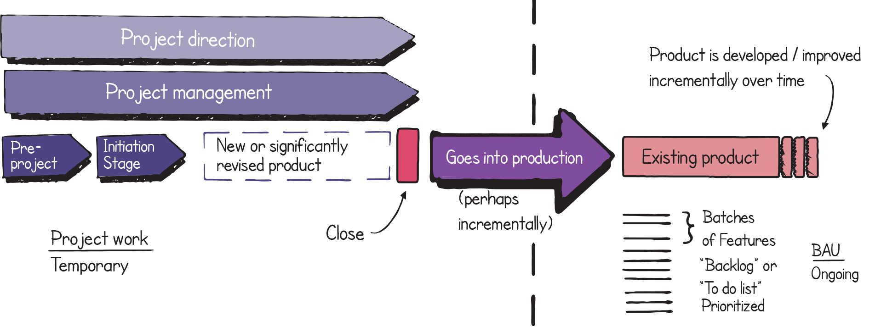
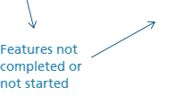
THE Difference between project work BAU work
Based on Axelos PRINCE2 Agile materials. Material is used under license from Axelos Limited. All rights reserved.
PRINCE2 and PRINCE2 Agile are registered trade marks of Axelos Limited, used under permission of Axelos Limited. All rights reserved.
Notes:
This diagram can be drawn whilst talking to the delegates on a flipchart if desired. This works best if the BAU side of the diagram i.e. the right-hand side, is drawn first. It is important to emphasise that this is routine ongoing work and does not need a project manager.
Once the right-hand diagram is complete and BAU is explained it may be worth mentioning that scrum is particularly good in this area.
When drawing the left-hand side of the diagram try to create the effect of a project management framework wrapping a product delivery approach. As this is being done, highlight the characteristics identified in the table on the previous slide.

Slide 19
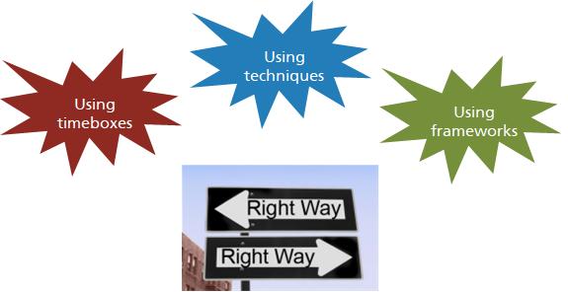
What is ‘agile’?
Copyright © Aspire Australasia Pty Ltd 2021-2022.
Notes:
So what do people think when they hear the word ‘agile’?
There are a number of common views:
Some see agile as the use of a timeboxed approach to developing new products in an iterative manner
Others see agile as using certain techniques, such as daily standups and retrospectives
Still others see agile as using a framework such as Scrum.
Many people nowadays have a broader view of agile. In fact, it may be that there is no ‘right’ way to be agile, it all depends on your context and experience.

Slide 20
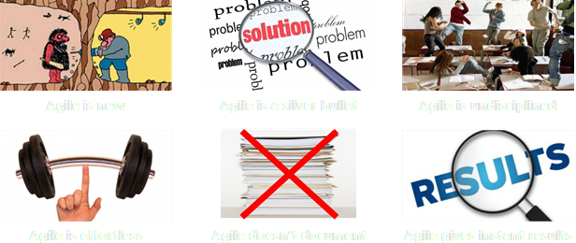
Myths about ‘agile’
New
A silver bullet
Undisciplined
Effortless
No documentation
Instant results
Copyright © Aspire Australasia Pty Ltd 2021-2022.
Notes:
There are many myths surrounding agile. Here are some of them.
Myth 1: Agile is new. Agile, or at least many of the techniques now labelled as ‘agile’, is not new. Agile methods have been around for a long time. The term ‘agile’ as currently used was adopted in 2001, with the Agile Manifesto, as a label for a wide range of disparate techniques. As such, ‘agile’ is an umbrella term which includes various agile practices and methods used globally, some of which predate the creation of the Agile Manifesto by 60 years.
Myth 2: Agile is a silver bullet. The use of an agile approach does not guarantee success. A project can fail as disastrously under agile as it can under other more traditional methods. In fact, one benefit of agile is that an ill-conceived project may tend to fail faster under agile due to the greater visibility and transparency that agile brings to such a project.
Myth 3: Agile is undisciplined. As soon as agile started gaining in popularity, its reputation suffered as the easy parts such as attending daily stand-ups were adopted, but the difficult parts such as regularly delivering production-ready product were not successfully adopted. The truth is that agile is a highly disciplined approach to product development.
Myth 4: Agile is effortless. Agile is not an ‘anything goes’ approach. In fact, it requires regular, frequent and evolutionary planning. And business must be willing to be actively and continuously engaged.
Myth 5: Agile doesn’t create documentation. Agile is not a justification for skipping documentation. Documentation is considered as important in agile, it’s just that face-to-face communication is preferred over the written word. Documentation that is produced is much more focused and condensed.
Myth 6: Agile gives instant results. An organisation may take years to identify, implement and continually improve an approach to agile that will work and be sustainable. While each project should still deliver results, the full benefits of agile development require the approach to become part of organisational DNA.

Slide 21
Agile style
Copyright © Aspire Australasia Pty Ltd 2021-2022.
Notes:
One way to think about agile is to compare two journeys.
If the final destination of a project can be specified in detail in advance, and if the solution development path can be planned in detail in advance, then the project’s journey could be likened to a train journey between two points A and B, with a predefined overall route and known way points between. If any change to either the destination or the route is required, it may be difficult or impossible to adjust once the project has started.
Alternatively, if the final destination of a project cannot be specified in detail in advance, or if the solution development path must be able to respond to changes in requirements or solution, then clearly an approach as rigid as a train journey would not be appropriate. Agile projects could be likened to a journey on a sailing ship, which must continually adjust course in response to changes in conditions.
The way in which a product development project should be set up and run may also depend on many parameters, and there is probably no one approach that will suit all projects.

Slide 22
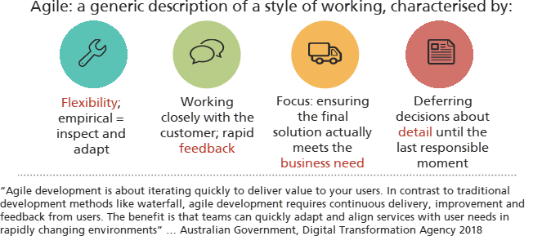
Defining agile
Copyright © Aspire Australasia Pty Ltd 2021-2022.
Notes:
Let’s spend a moment considering what we mean when we use the word ‘agile’?
Here are 4 aspects that are generally associated with ‘agile’.
Agile provides flexibility. In particular the flexibility to deal with situations where the customer can’t specify in detail what they want, or if they could, there’s not enough time or money available to deliver everything they’re asking for. Or situations where the supplier doesn’t know what specific solution is likely to satisfy the customer’s needs. Or where the customer’s needs and the nature of the solution required must be adapted to a rapidly changing environment. The approach taken by agile methods is an empirical approach, in which a small step forward is taken, then the customer and supplier inspect the results, learn a little more about what is really needed, then adapt the requirements or their ideas about the solution, before taking another small step and repeating this process.
Agility requires the customer and supplier to work closely. This supports effective communication, and enables rapid feedback from one to the other.
Agile methods should ensure that the solution actually addresses the customer’s most important business needs. Sometimes this means that the available time or money only permit the customer's most important needs to be addressed, and that lower priority needs are deferred.
A final aspect of many agile approaches is that decisions about detail are deferred until the last responsible moment. This is required in part to enable flexibility and allow time for the customer and supplier view of the business need and possible solutions to evolve as their shared understanding increases.
Here is a succinct way of describing agile product development, from an Australian Government agency: Agile development is about iterating quickly to deliver value to your users. In contrast to traditional development methods like waterfall, agile development requires continuous delivery, improvement and feedback from users. The benefit is that teams can quickly adapt and align services with user needs in rapidly changing environments.

Slide 23
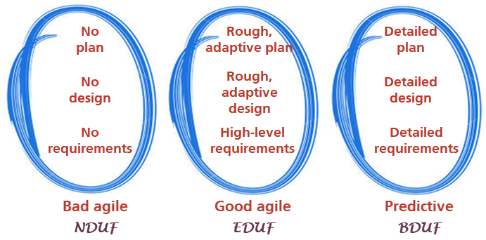
Enough design up front
Copyright © Aspire Australasia Pty Ltd 2021-2022.
Notes:
A good agile approach deals with its uncertainties around the solution required and its development path by putting in place just enough support scaffolding, in terms of high-level requirements, the overall shape of the solution and the outline of a delivery plan, and then developing more detail as the need arises. Agile people summarise this as ’enough design up front’ or EDUF. Agile people describe conventional predictive approaches as having a ‘big design up front’ or BDUF approach. At the opposite extreme would be an approach where no preparatory work was done, which could be called a ‘no design up front’ or NDUF approach. Many people call this ‘fragile agile’.

Slide 24
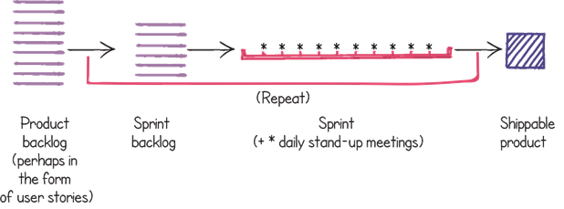
Generic agile workflow
Based on Axelos PRINCE2 Agile materials. Material is used under license from Axelos Limited. All rights reserved.
PRINCE2 and PRINCE2 Agile are registered trade marks of Axelos Limited, used under permission of Axelos Limited. All rights reserved.
Notes:
Let’s finish this introduction to agile by introducing a typical agile product development workflow. This diagram shows a basic backlog and sprint structure, such as is used in Scrum.
A backlog of broad product requirements is developed that captures what the customer needs. A subset of these requirements is extracted, and decomposed into smaller entries in the sprint backlog. A sprint is a timebox within which the development team will seek to develop or enhance products so that they satisfy the requirements in the sprint backlog. The output of each sprint should be a product that can be demonstrated to the customer, and be potentially shippable. After a sprint has been completed, this process repeats, until the product backlog is empty.

Slide 25
Introducing PRINCE2
PRINCE2 and PRINCE2 Agile are registered trade marks of Axelos Limited, used under permission of Axelos Limited. All rights reserved.

Slide 26
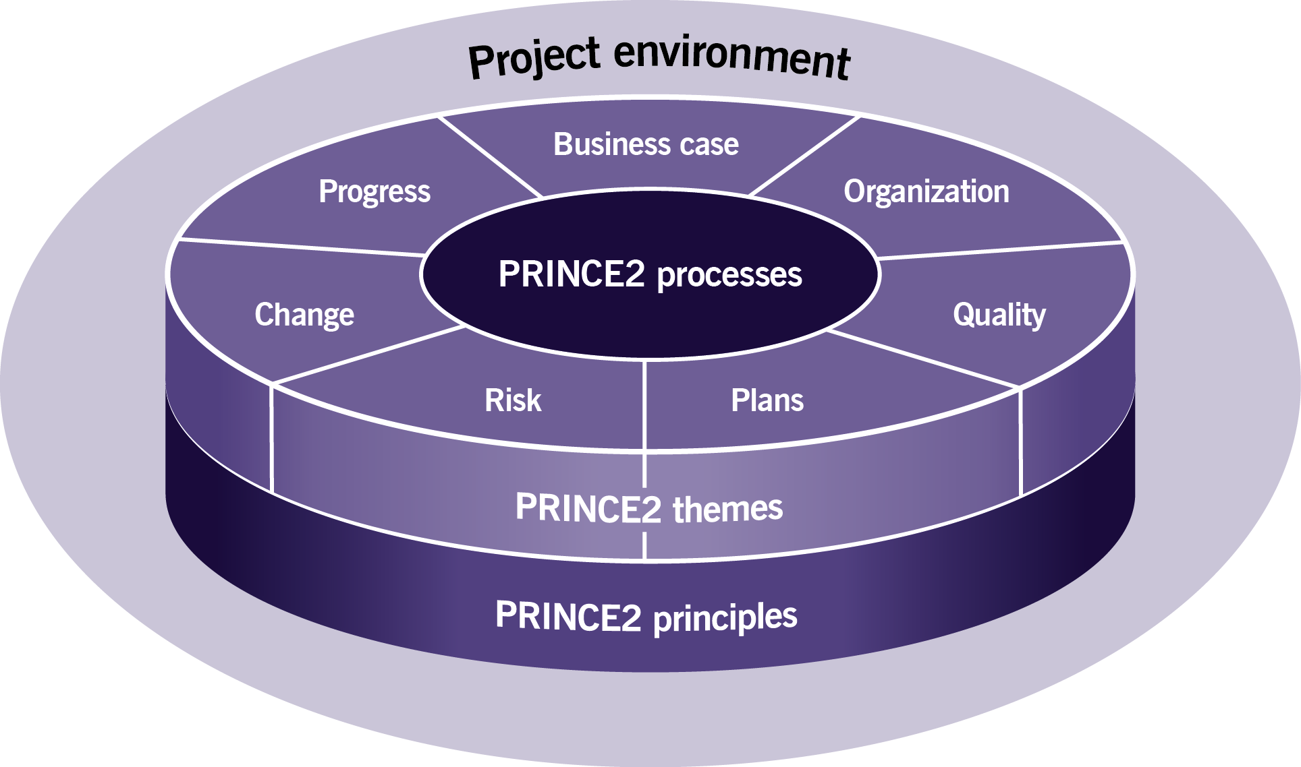
PRINCE2
Based on Axelos PRINCE2 Agile materials. Material is used under license from Axelos Limited. All rights reserved.
PRINCE2 and PRINCE2 Agile are registered trade marks of Axelos Limited, used under permission of Axelos Limited. All rights reserved.
Notes:
By now we will know what background our attendees have... If we have P2 qualified attendees then this can be a brisk reminder...
Make it fun: turn it into a quiz where people working in pairs are asked to remember the seven themes, the seven processes and the seven principles.
Management products might be a lot harder although you could turn this into a game of ‘killer’ whereby the first one to get one wrong makes the coffees.
If we have attendees that have no P2 background use this section to give them the basic structure.

Slide 27
Prince2 principles
The guiding obligations for good practice that a project should follow:
Continued business justification
Learn from experience
Defined roles and responsibilities
Manage by stages
Manage by exception
Focus on products
Tailor to suit the project
Based on Axelos PRINCE2 Agile materials. Material is used under license from Axelos Limited. All rights reserved.
PRINCE2 and PRINCE2 Agile are registered trade marks of Axelos Limited, used under permission of Axelos Limited. All rights reserved.
Notes:
These can’t be tailored... This is what makes PRINCE2 what it is.
A quick review of each for understanding.
Take the time to point out how very agile all of these are... There is nothing in this foundation stone that is anti agile.

Slide 28
Prince2 THEMES
Theme | What does it do?
Business case | Creates and maintains a business justification for the project. Ensures project outcomes are achieved and benefits realized.
Organization | Defines the project organization structure and roles. Defines the approach to communicating and engaging with stakeholders.
Quality | Defines the project quality management approach. Specifies prioritized acceptance criteria for the final project product(s).
Plans | Recommends different levels of plan to facilitate communication and control from the differing perspectives of the project organization. Plans enable the business case to be realized.
Risk | Defines the risk management approach and ensures that project risks are identified, assessed and controlled.
Change | Defines the change control approach and ensures that issues are captured, assessed and controlled.
Progress | Defines the way that the project progress is measured and compared to performance targets. Progress enables a forecast of the continuing project viability.
Based on Axelos PRINCE2 Agile materials. Material is used under license from Axelos Limited. All rights reserved.
PRINCE2 and PRINCE2 Agile are registered trade marks of Axelos Limited, used under permission of Axelos Limited. All rights reserved.
Notes:
This table is intended to be used to give a thumb nail sketch of the themes to someone with little or no knowledge of PRINCE2. It is not simply the purpose of each theme but more a description of what an individual theme does for the project. Remember it is the purpose of each theme that is tested in the foundation exam.

Slide 29
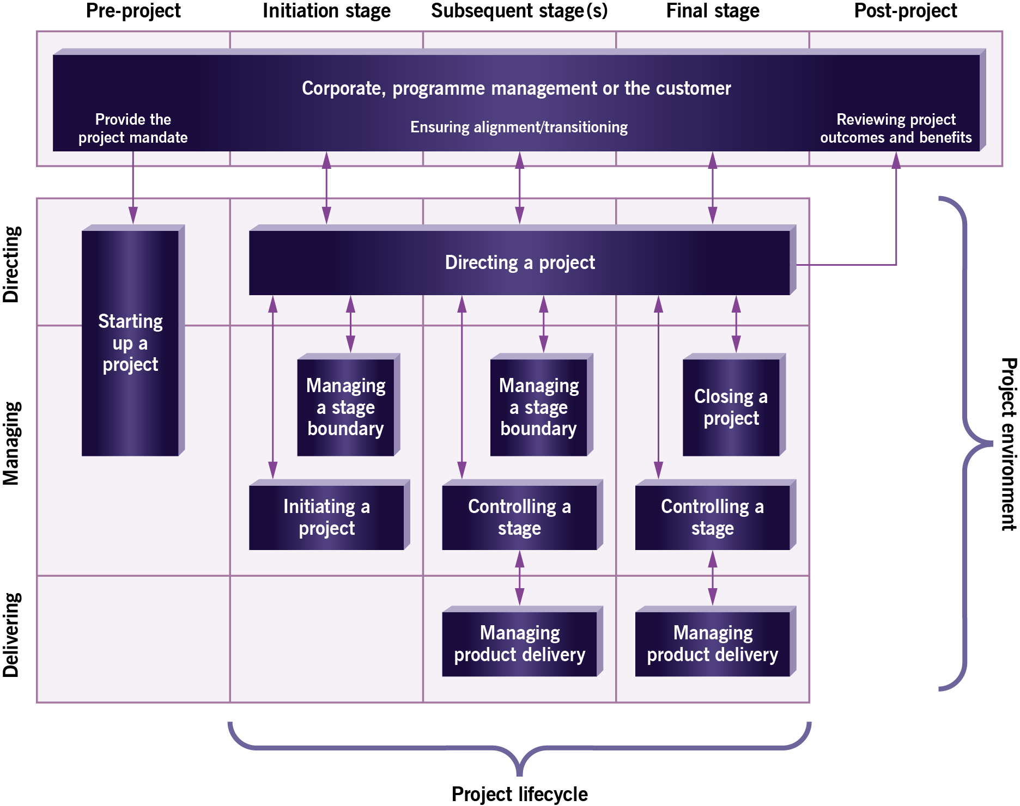
PRINCE2 processes and themes
Business case
Organization
Quality
Plans
Risk
Change
Progress
Based on Axelos PRINCE2 Agile materials. Material is used under license from Axelos Limited. All rights reserved.
PRINCE2 and PRINCE2 Agile are registered trade marks of Axelos Limited, used under permission of Axelos Limited. All rights reserved.
Notes:
The foundation exam requires that we understand the purpose of the processes and themes.
This is either reading to be done overnight, review and discussion now... Or there are a couple of simple activities to address this.
Take time with this... We need to understand PRINCE2 before we can understand how to tailor it.
Explain the relationship between the processes and the themes.
The processes provide a broad structure for the project, they provide hints, tips and checklists to help us think through the direction and management of the project. They show the link to the delivery level.
The themes provide advice and guidance on how to accomplish key elements of the project.

Slide 30
Prince2 management products
There are 26 management products that support the PRINCE2 method. All can and should be tailored.
Key to successfully tailoring the method are the following:
Business case
Checkpoint report
Highlight report
Project brief
Project initiation documentation
Project product description
Work package
Based on Axelos PRINCE2 Agile materials. Material is used under license from Axelos Limited. All rights reserved.
PRINCE2 and PRINCE2 Agile are registered trade marks of Axelos Limited, used under permission of Axelos Limited. All rights reserved.
Notes:
The above 7 management products are all tested in the P2A foundation exam for understanding of their purpose. Attendees need to be guided to read this section as part of their preparations. It is also possible to turn this into a simple matching activity.
Link the management products above to the processes and themes. We do not want to get into detail here... This is just an introduction to the key management products that we will examine in detail later.
The foundation exam requires that the purpose of these documents is understood. See appendix A.
It might be fun to play pin the tail on the donkey (or a similar game)... Ask the class where each of these is created in the previous process diagram.
Note there is also a reference to these products in the activities.
Please note that the 2017 P2 manual explicitly says that management products do not need to be formal documents or text docs... They could be slides. Spreadsheets or data in systems... Reports could be emails, notes of meetings, wall charts or just an entry in a daily log.

Slide 31
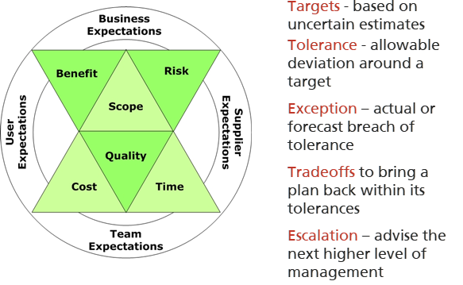
PARAMETERS, TARGETS, TOLERANCE
Copyright © Aspire Australasia Pty Ltd 2021-2022.
Notes:
The above 7 management products are all tested in the P2A foundation exam for understanding of their purpose. Attendees need to be guided to read this section as part of their preparations. It is also possible to turn this into a simple matching activity.
Link the management products above to the processes and themes. We do not want to get into detail here... This is just an introduction to the key management products that we will examine in detail later.
The foundation exam requires that the purpose of these documents is understood. See appendix A.
It might be fun to play pin the tail on the donkey (or a similar game)... Ask the class where each of these is created in the previous process diagram.
Note there is also a reference to these products in the activities.
Please note that the 2017 P2 manual explicitly says that management products do not need to be formal documents or text docs... They could be slides. Spreadsheets or data in systems... Reports could be emails, notes of meetings, wall charts or just an entry in a daily log.

Slide 32
The prince2 journey with agile
How PRINCE2 may look in an agile context
Please note the word ‘typically’
…and ‘a way’ not ‘the way’
Tailoring PRINCE2 depends on the project context and may affect:
the level of formality
where the emphasis is placed
how it is carried out.
Based on Axelos PRINCE2 Agile materials. Material is used under license from Axelos Limited. All rights reserved.
PRINCE2 and PRINCE2 Agile are registered trade marks of Axelos Limited, used under permission of Axelos Limited. All rights reserved.
Notes:
It may be worth mentioning why this is being referenced at this point. It is because there is something in the PRINCE2 manual called ‘the PRINCE2 journey’ and as part of the baselining of PRINCE2 Agile (in section 1 of the manual) this has been included to show how it would look in an agile context. What this enables the trainer to do at this point, is to give a very quick overview (or helicopter view) of PRINCE2 Agile in order to explain to delegates that the detail of this will be carried out during the rest of the course.
Stress that the PRINCE2 journey with agile is a way not the way and it would be appropriate at this point to explain that a lot of information and guidance throughout the manual is in a similar style: namely it is giving you guidance on how you could approach certain situations. Because agile comes in many forms and varieties, it is often difficult to give specific advice and to say that for example ‘estimation must be done in a certain way’. So using this journey slide gives an opportunity for the trainer to bring in this concept of a way and not necessarily the way. There are ‘many ways to skin a cat’ (or other similar appropriate example) you may prefer to describe this more appropriately.

Slide 33
Agile ways of working
PRINCE2 and PRINCE2 Agile are registered trade marks of Axelos Limited, used under permission of Axelos Limited. All rights reserved.

Slide 34
PRINCE2 Agile’s view
PRINCE2 Agile
regards agile as being a ‘family of behaviours,
concepts,
frameworks and
techniques’.
Based on Axelos PRINCE2 Agile materials. Material is used under license from Axelos Limited. All rights reserved.
PRINCE2 and PRINCE2 Agile are registered trade marks of Axelos Limited, used under permission of Axelos Limited. All rights reserved.
Notes:
PRINCE2 Agile regards agile as being a ‘family of behaviours, concepts, frameworks and techniques’.
Many people would also say that agile requires the right mindset, not just at an individual or team level, but also at an organisational level. Following this line, it’s probably more important to ‘be agile’ rather than just ‘do agile’.

Slide 35
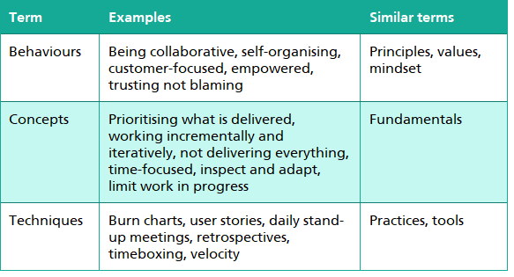
Agile behaviours, concepts and techniques
Based on Axelos PRINCE2 Agile materials. Material is used under license from Axelos Limited. All rights reserved.
PRINCE2 and PRINCE2 Agile are registered trade marks of Axelos Limited, used under permission of Axelos Limited. All rights reserved.
Notes:
Here are some examples of the behaviours, concepts and techniques that are seen as being part of the agile way of working.
It is important to note that the entries in this table are for illustration only; this is not a definitive list.
It’s also important to note that many of the techniques used in agile can be used quite happily in a predictive context.

Slide 36
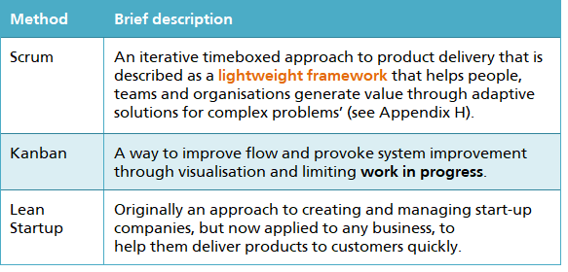
Agile frameworks
Based on Axelos PRINCE2 Agile materials. Material is used under license from Axelos Limited. All rights reserved.
PRINCE2 and PRINCE2 Agile are registered trade marks of Axelos Limited, used under permission of Axelos Limited. All rights reserved.
Notes:
Scrum, Kanban and Lean Startup are agile frameworks that are suitable for use with PRINCE2 Agile. They are described in the manual.
Note that there was a conscious decision in the PRINCE2 Agile manual not to go into great detail on all of the agile methods that are available. This was to avoid inaccurate interpretations.
We’ll look at these 3 frameworks in a little more detail.

Slide 37
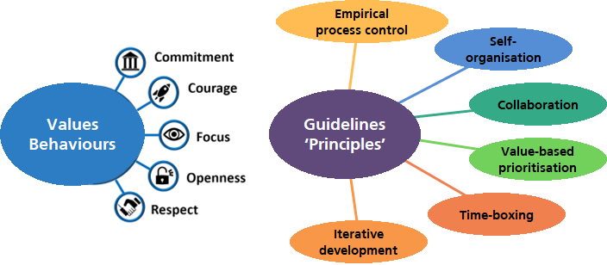
Scrum Overview
Copyright © Aspire Australasia Pty Ltd 2021-2022.
Notes:
Scrum is based on a number of values or behaviours expected of all team members.
Commitment: team members personally commit to achieving the goals of the team.
Courage: team members have the courage to do the right thing, and to work on difficult problems.
Focus: everyone focusses on the work of the team and its goals.
Openness: the team and its stakeholders agree to be open about all the work, and the challenges with performing the work.
Respect: team members respect each other as capable, independent people.
Scrum also provides a set of guidelines (that it calls principles).
Empirical process control. Empirical means evidenced-based, so empirical process control means that the team controls its processes based on what they experience, not what they wish was happening. If they need to change a process to get a better result, they change it. The team works collaboratively to inspect, evaluate and adapt what they are doing with full transparency. Self-organisation. One of the keys to Scrum is a self-organising team. There is no formal hierarchy within the team. The team is empowered to make decisions as a group and to organise the work among themselves. The purpose of this guideline is to create an environment of shared ownership and enhanced buy-in for the work. Typically, people are more engaged if they have a greater say over their work and how they carry out their tasks, so this guideline should lead to a team with higher levels of motivation and a pleasant working culture. Collaboration. Team members need to understand how to work with each other, and to maintain open communication with stakeholders outside of the team. In order to collaborate, each person needs to be aware of what others are doing. That should help ensure that all the team’s outputs can be integrated once the work is complete, and everything should work smoothly together. Value-based prioritisation: Value-driven delivery is at the core of agile methods, and Scrum makes that clear by including prioritisation in its guidelines. This means that work is structured to put greater emphasis on the tasks and outputs that are going to bring the most value. The highest priority tasks are worked on first. Timeboxing: The timeboxing guideline is all about managing work within a set time period. The team does what can be realistically achieved in that time period and anything else has to wait until the next timebox. Teams use timeboxing in a variety of ways: daily meetings (timeboxed at, for example, 15 minutes), reviews, retrospectives, sprints (timeboxed at a month or less), and releases. Iterative development: Iterative development is key to Scrum, and all agile approaches. It is the idea of building products in small steps, with lots of feedback between each step. It’s a simple way to build a product that the customer really needs, not what they initially think they want. This guideline allows teams to deliver value in chunks, building more and more functionality in layers to create the final product. This guideline also allows the team to flexibly incorporate learning and change.

Slide 38
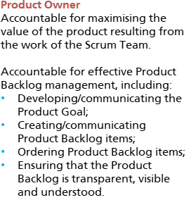
Scrum Roles – product owner
Based on Axelos PRINCE2 Agile materials. Material is used under license from Axelos Limited. All rights reserved.
PRINCE2 and PRINCE2 Agile are registered trade marks of Axelos Limited, used under permission of Axelos Limited. All rights reserved.
Notes:
Scrum defines 3 roles. We’ll look at each in turn.
The Product Owner is accountable for maximising the value of the product resulting from the work of the Scrum Team, and for effective management of the Product Backlog.

Slide 39
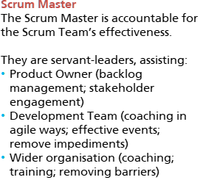
Scrum Roles – Scrum Master
Based on Axelos PRINCE2 Agile materials. Material is used under license from Axelos Limited. All rights reserved.
PRINCE2 and PRINCE2 Agile are registered trade marks of Axelos Limited, used under permission of Axelos Limited. All rights reserved.
Notes:
The Scrum Master is accountable for the Scrum Team’s effectiveness. They serve the Product Owner, the Development Team, and the wider organisation.

Slide 40
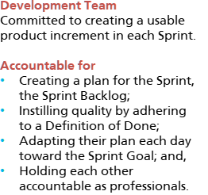
Scrum Roles – development team
Based on Axelos PRINCE2 Agile materials. Material is used under license from Axelos Limited. All rights reserved.
PRINCE2 and PRINCE2 Agile are registered trade marks of Axelos Limited, used under permission of Axelos Limited. All rights reserved.
Notes:
The Development Team is committed to creating a usable product increment in each Sprint.

Slide 41
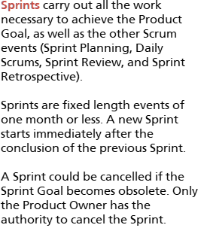
Scrum events – sprintS
Based on Axelos PRINCE2 Agile materials. Material is used under license from Axelos Limited. All rights reserved.
PRINCE2 and PRINCE2 Agile are registered trade marks of Axelos Limited, used under permission of Axelos Limited. All rights reserved.
Notes:
The Sprint is the core event in Scrum, in which ideas are turned into value. The Sprint is also a container for other events. Each event in Scrum is a formal opportunity to inspect and adapt Scrum artefacts. These events are specifically designed to enable the transparency required. Failure to conduct any event as prescribed results in lost opportunities to inspect and adapt. Events are used in Scrum to create regularity and to minimize the need for meetings not defined in Scrum.
Sprints carry out all the work necessary to achieve the Product Goal.

Slide 42
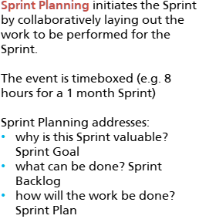
Scrum events – sprint Planning
Based on Axelos PRINCE2 Agile materials. Material is used under license from Axelos Limited. All rights reserved.
PRINCE2 and PRINCE2 Agile are registered trade marks of Axelos Limited, used under permission of Axelos Limited. All rights reserved.
Notes:
Sprint Planning initiates the Sprint by collaboratively laying out the work to be performed within the Sprint.

Slide 43
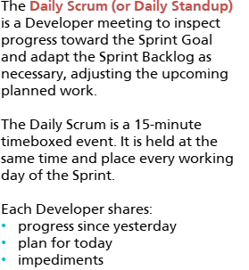
Scrum events – Daily scrum (daily standup)
Based on Axelos PRINCE2 Agile materials. Material is used under license from Axelos Limited. All rights reserved.
PRINCE2 and PRINCE2 Agile are registered trade marks of Axelos Limited, used under permission of Axelos Limited. All rights reserved.
Notes:
The Daily Scrum is a Developer meeting to inspect progress toward the Sprint Goal and adapt the Sprint Backlog and adjust the remaining work in the Sprint.

Slide 44
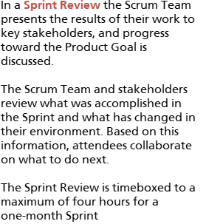
Scrum events – sprint review
Based on Axelos PRINCE2 Agile materials. Material is used under license from Axelos Limited. All rights reserved.
PRINCE2 and PRINCE2 Agile are registered trade marks of Axelos Limited, used under permission of Axelos Limited. All rights reserved.
Notes:
In a Sprint Review, the results achieved in the Sprint are presented to key stakeholders. Based on progress and any changes, attendees decide on what should be done next.

Slide 45
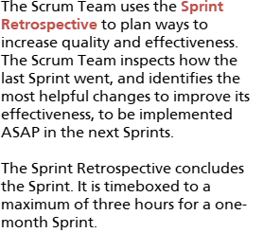
Scrum events – sprint retrospective
Based on Axelos PRINCE2 Agile materials. Material is used under license from Axelos Limited. All rights reserved.
PRINCE2 and PRINCE2 Agile are registered trade marks of Axelos Limited, used under permission of Axelos Limited. All rights reserved.
Notes:
The Scrum Team uses the Sprint Retrospective to identify ways to increase the quality and effectiveness of their processes and behaviours.

Slide 46
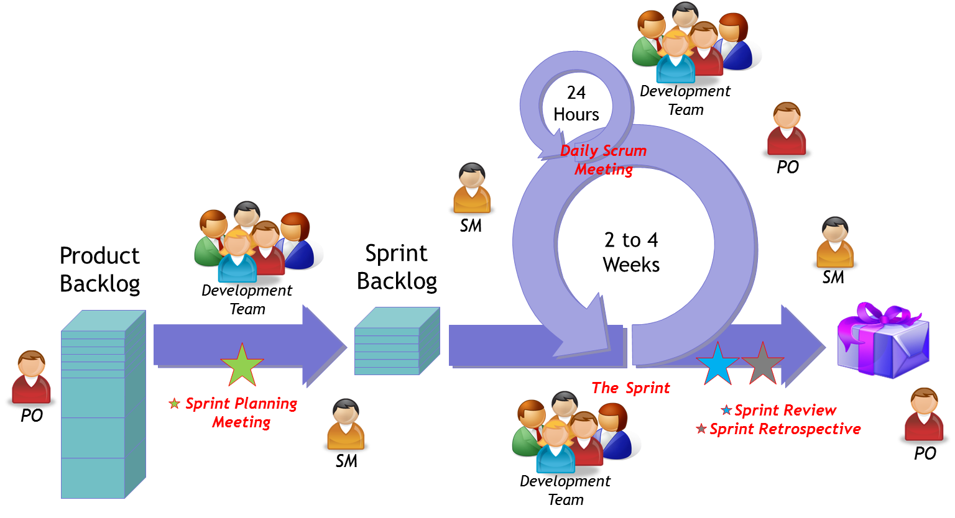
Scrum Workflow
Based on Axelos PRINCE2 Agile materials. Material is used under license from Axelos Limited. All rights reserved.
PRINCE2 and PRINCE2 Agile are registered trade marks of Axelos Limited, used under permission of Axelos Limited. All rights reserved.
Notes:
This diagram shows the flow of work in Scrum. It shows the roles in the scrum team, various events and artefacts, and the definitions of ready and done. Let’s start at the left.
The PO creates, manages and prioritises the product backlog. Prioritisation is based primarily on business value.
The PO works with the team to agree the sprint backlog, based upon the team’s velocity (or how much work they think they can complete in the sprint).
Entries in the sprint backlog must meet a definition of ready (which is a standard that the team has agreed that means that the entries as written can be developed in the sprint).
The dev team are self-organising, collaborative and cross-functional. They deliver the objectives of the sprint (which is usually 2 – 4 weeks in length).
When they’re able to, dev team members PULL stories from the sprint backlog forward into the sprint.
The dev team create outputs that meet a definition of done (which is a standard that the team has agreed that defines the quality and completeness of a finished piece of work). These outputs are intended to be as close to a shippable product as is possible.
The sprint output is demonstrated to the customer by the dev team in the Sprint Review, and “accepted” by the PO.
The dev team “inspects itself” in a Sprint Retrospective. They look back at what happened during the sprint, and reflect on what might be improved. They will then agree on improvements they would like to make over coming sprints.
Then the cycle repeats for each of the following sprints, until the product backlog is empty.

Slide 47
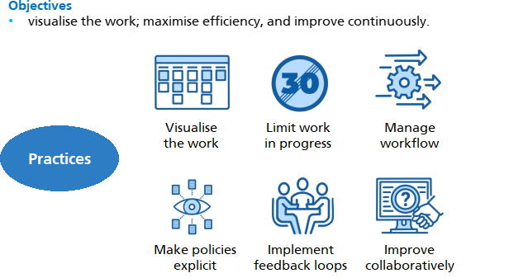
Kanban overview
Copyright © Aspire Australasia Pty Ltd 2021-2022.
Notes:
Kanban is a just-in-time scheduling system for lean manufacturing, also called just-in-time manufacturing. It was originally developed by Taiichi Ohno at Toyota, to improve manufacturing efficiency. Kanban is a visual signalling system that takes its name from the cards that track product levels in a factory.
Kanban is now also used as a workflow management method for defining, managing and improving services that deliver knowledge work. It aims to help a team visualise its work, maximise efficiency, and improve continuously.
There are a number of broad practices within the Kanban method.
It seeks to visualise the work. The team understands its capacity constraints, progress and status of all tasks. If a bottleneck is recognised, the team will swarm on the problem.
It limits work-in-progress, to avoid multitasking and overload of team members.
It encourages the team to manage its workflow. Team members pull work from the backlog when they have the capacity. Kanban does not impose a fixed length timebox like Scrum, but is more of a flow system.
It seeks to make the team’s policies and processes explicit, so that people can move in and out of the team as needed.
It seeks to implement feedback loops, supported by many events or ‘ceremonies’.
Kanban seeks continuous and incremental change and collaborative improvement.

Slide 48
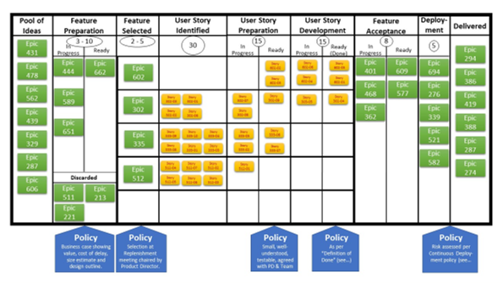
Kanban board
Copyright © Aspire Australasia Pty Ltd 2021-2022.
Notes:
This diagram shows a Kanban Board, which promotes the visibility of the work of a team. The board consists of columns which are the phases in the lifecycle of products as they are being developed. Each item of work is represented as a card on the board. Initially all of the cards, representing the backlog to be worked on, are in the first column. When a person can start working on a card, they’ll move it right. Cards in the right hand column represent completed work.
There are a number of other Kanban features on the diagram worth pointing out.
The board shows the limits on work in progress. These are the numbers in circles at the top of the columns.
The board also displays the policies or agreed guidelines to be followed at each step. These create a common foundation for all team members to understand how to do any type of task in the system.
Finally, note the various columns labelled as ‘ready’. These indicate that items are ready to be moved to the next phase of the product development lifecycle.
Kanban boards are regularly used by Scrum Development Teams to track releases and sprints.

Slide 49
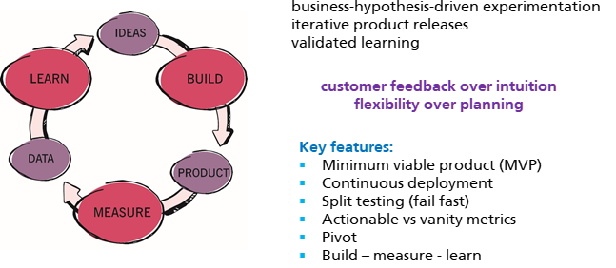
Lean startup
Based on Axelos PRINCE2 Agile materials. Material is used under license from Axelos Limited. All rights reserved.
PRINCE2 and PRINCE2 Agile are registered trade marks of Axelos Limited, used under permission of Axelos Limited. All rights reserved.
Notes:
Lean Startup was developed to assist startup companies. But its ideas have great merit in the context of any agile project.
Lean startup is a method for developing businesses and products that aims to shorten product development cycles and rapidly discover if a proposed business model or product is viable. This is achieved by adopting a combination of business-hypothesis-driven experimentation, iterative product releases, and validated learning.
Lean startup emphasizes customer feedback over intuition, and flexibility over planning.
There are a number of key features of the Lean Startup method.
A minimum viable product (MVP) is a version of a new product which allows a team to collect the maximum amount of validated learning about customers with the least effort. The goal of an MVP is to test fundamental business hypotheses (or assumptions) and to help businesses begin the learning process as quickly as possible. An MVP could be a prototype
For software development, continuous deployment is a process whereby all software that is written for an application is immediately deployed into production, which results in a reduction of cycle times.
A split or A/B test is an experiment in which different versions of a product are offered to different customer groups at the same time. The goal of a split test is to observe differences in behaviour between the two groups, and to measure the impact of each version on an actionable metric.
Lean Startup differentiates between actionable metrics and vanity metrics. Actionable metrics should be linked directly to the objectives of the company, and lead to informed business decisions and subsequent action. These are in contrast to vanity metrics that give the rosiest picture possible but do not accurately reflect the key drivers of a business. For example, ‘new customers gained today’ is a vanity metric, because it looks good on paper, but if the cost of acquiring each new user exceeds the additional revenue from that user, you’ll soon be out of business.
A pivot is a structured course correction designed to test a new fundamental hypothesis about the product, strategy, or engine of growth. A pivot might be needed if the original hypothesis has been proven to be incorrect.
The Build–Measure–Learn loop emphasizes speed as a critical ingredient to customer development. A team or company's effectiveness is determined by its ability to ideate, quickly build a minimum viable product from that idea, measure its effectiveness in the market, and learn from that experiment. In other words, it is a learning cycle that turns ideas into products, measures customers' reactions and behaviours towards these products, and then decides whether to persevere or pivot the idea; this process repeats as many times as necessary. The process can also be viewed as a way to test hypotheses.

Slide 50
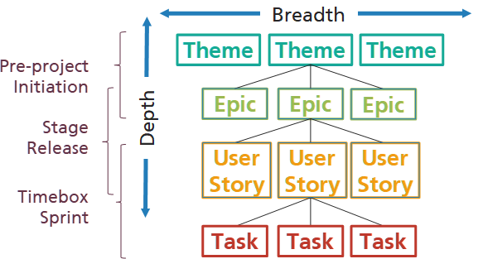
Hierarchy of Requirements
Copyright © Aspire Australasia Pty Ltd 2021-2022.
Notes:
Now we’ll introduce some commonly used agile techniques.
We’ll start by looking at agile representations of requirements.
Early in the life of a project, the scope of the project will be represented by a small number of really broad requirements, representing the business' vision for the project. This establishes the ‘breadth’ or scope of requirements. As the project progresses, the need to derive better estimates and understand products in more detail will be supported by the development of a greater level of understanding of these requirements. This is sometimes described as increasing the depth of understanding of requirements.
In many agile frameworks, requirements at the lowest level are usually represented as ‘user stories’. Various names can be applied to higher levels of requirements; these include ‘themes’ at the highest level, and ‘epics’ at an intermediate level. There are various definitions of ‘themes’ and ‘epics’, but there is no universally accepted definition of either. Themes represent the critical building blocks of the solution, Epics are large features that collectively make up a theme, and User stories are the meaningful requirements that the delivery team will take into a timebox.
The broad scope of a project will be captured early in the project as Themes or Epic requirements. A greater understanding of these requirements will be developed as the backlogs for stages, releases and sprints are developed, and captured as User Stories. When planning a sprint, the delivery team may find it useful to break up the work associated with satisfying a User Story by splitting it into more granular user stories, or even tasks that will be performed by various team members. If the delivery team fully understand what is meant by a requirement, and how to satisfy the requirement, then there is no need to increase the depth of understanding of that requirement.

Slide 51
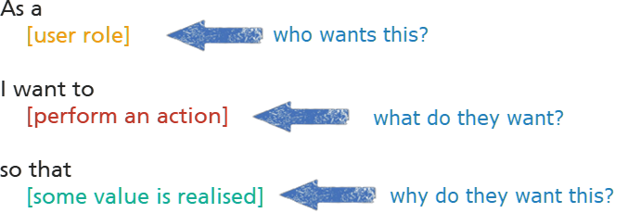
Introducing user stories
Copyright © Aspire Australasia Pty Ltd 2021-2022.
Notes:
Many agile methods capture requirements as User Stories. Alistair Cockburn was the first person to use the term “User Story”. A User Story is a simple way to capture initial thoughts on requirements. It describes the expected behaviour of the solution from the perspective of a user.
All User Stories have the same three-part format:
A statement that starts with ‘As a …’, that describes the user or role or persona that is the actor in the story;
A statement that starts with ‘I want …’, that describes the action the actor expects the solution to support, or the goal they expect to be able to achieve; and
A statement that starts with ‘So that …’, that describes the actor’s purpose in wanting to be able to take that action, or the benefit or value that will be realised as a result. The User Story format is effective for expressing requirements because the focus is on the roles that will use or be impacted by the solution, and defines their needs in language that is meaningful to them. It also clarifies the true reason for the requirement. The User Story should define the requirement at a high level, without going into low-level detail too early. It is deliberately brief, to encourage an ongoing conversation between customer and supplier.

Slide 52
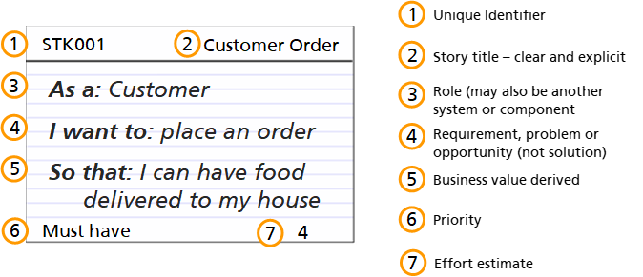
User story card - front
Copyright © Aspire Australasia Pty Ltd 2021-2022.
Notes:
User Stories were originally written on cards. Although there are now many software tools that are used, the information content hasn’t changed much.
Here is an example of the front of a User Story card.
Each user story should have a unique identifier, and a short title that summarises the user story.
The three elements of the user story should then be laid out.
After further analysis, the user story will be allocated a priority, and an estimate of the effort associated with satisfying the user story.

Slide 53
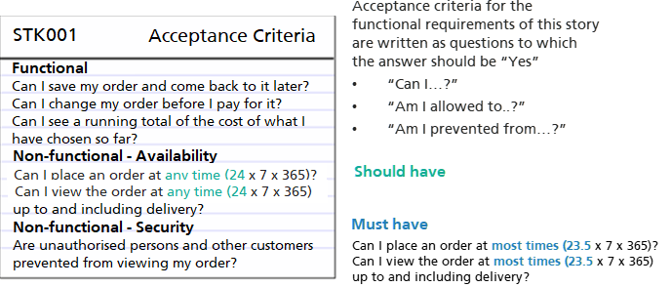
User story card - rear
Copyright © Aspire Australasia Pty Ltd 2021-2022.
Notes:
On the back of a User Story card will be the acceptance criteria associated with the user story.
The acceptance criteria for the functional requirements of the story should be written as questions that have a black or white answer, such as “Yes” or “No”, meaning that the solution either does or does not satisfy the requirement.
Although the acceptance criteria for the non-functional requirements are written here in the same format, it is also possible to write these as ranges of values, or to allocate a MoSCoW priority. For example, the availability criteria shown on this card say 24 hours a day by 7 days each week by 365 days per year. These criteria could be allocated a priority of Should have. Another set of matching criteria might be added to the card, and allocated a Must have priority, that says the solution must be available to take and view orders for 23 ½ hours every day, which allows a ½ hour every day for solution maintenance to occur.
The acceptance criteria on the user story card provide the basis for creation of appropriate test scenarios and test scripts by solution testers.

Slide 54
Estimating in agile environments
Copyright © Aspire Australasia Pty Ltd 2021-2022.
Notes:
Now let’s look at estimating in an agile environment.
When people are asked to provide estimates in terms of time or money, they may feel like they’re under a lot of pressure, because time and money, as units of currency in the project, really matter.
Agile approaches tend to derive initial estimates in terms of some meaningless currency, rather than time or money, which removes this source of pressure.

Slide 55
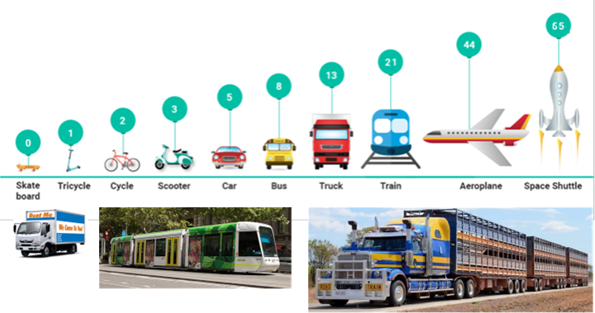
Agile Estimating BY relative size
Copyright © Aspire Australasia Pty Ltd 2021-2022.
Notes:
Most agile estimation techniques rely on our ability to be able to compare two things and form judgements about their relative sizes. Relative sizing estimation works because comparing something with something else is much quicker and more accurate than deconstructing that thing into its component parts.
For example, suppose we had established the scale shown in this diagram. Where on this scale would you put a tram, which is a light rail vehicle which is bigger than a bus, but smaller than a train? You might put it with the trucks, and re-label the group as ‘heavy road vehicles’. Or you might split the ‘truck’ group into ‘light trucks’ and ‘heavy trucks’, and create a ‘tram’ group between them.

Slide 56
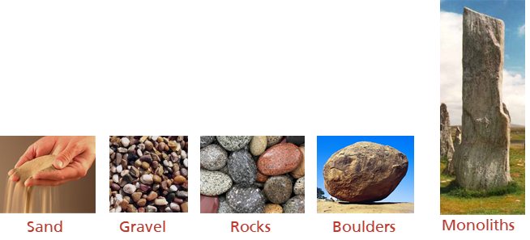
Agile Estimating – t-shirt sizing
Copyright © Aspire Australasia Pty Ltd 2021-2022.
Notes:
Another estimating technique used in many agile approaches is called the T-shirt sizing technique.
In this technique, we establish arbitrary groups. Here, they’ve been labelled as small, medium and large. We look through our user stories, and select one that seems to be average in terms of our feeling as to the effort we might have to expend to get it to done in a timebox. We’ll move this to the ‘medium’ column. We’ll then select the next user story, and compare it to the first one. If it seems that it would take roughly the same amount of effort to get it to ‘done’, we’ll move it to the ‘medium’ column. If we think it would take much less effort, we’ll move it to the ‘small’ column. If we think it would take much more effort, we’ll move it to the ‘large’ column.
If we find a user story that we feel is much larger than those in the ‘large’ column, we could create an ‘extra large’ column, and move it there. If we found a user story that was much smaller than those in the ‘small’ column, we could create an ‘extra small’ column, and move it there.
We continue doing this for each user story in the backlog.
Then, we select one user story from each column to act as the reference story for that column, and develop estimates of effort, cost and duration for each of these stories. All user stories in the same column receive the same estimates. The total estimates for all user stories in all columns are then added up to give estimates at project level.
Some agile teams amuse themselves by replacing the t-shirts with something else, such as dogs. Other teams use labels aligned with stones of different sizes. The labels we put on each column don’t matter, as long as everyone agrees about the relative sizing of each column.

Slide 57
Agile Estimating – story point sizing
Copyright © Aspire Australasia Pty Ltd 2021-2022.
Notes:
Yet another relative sizing technique is story point estimating. This technique uses a currency called ‘story points’.
Story point estimating is a consensus based technique. Using group discussions, each user story is considered, and allocated a number of story points, based on its relative size compared with other user stories, in much the same way as in t-shirt sizing. The allocated story points are then written onto the user story card.
In order to provide those in organisational and project-level roles with estimates of the project’s likely cost and duration, conversion factors need to be applied. One of these conversion factors is called ‘velocity’, usually expressed as the number of story points the delivery team can get to done in a timebox of an agreed length. The velocity factor allows us to use the delivery team’s previous performance to forecast what can be expected in future from this team. By applying velocity, we can work out from the total story point count for a project how many timeboxes will be needed. Then we multiply that number by the usual timebox length in days or weeks, to give us the estimated project duration. Given that the entire delivery team is expected to participate in each timebox, the Project Manager can then work out the project’s labour cost.

Slide 58
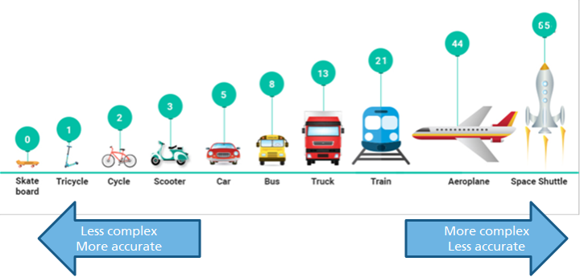
Agile Estimating – using the Fibonacci sequence
Copyright © Aspire Australasia Pty Ltd 2021-2022.
Notes:
The story points allocated to a user story should reflect the size, complexity, and effort needed for completing or implementing that story. For larger user stories, we expect that there will be greater uncertainty related to the story, and that our estimates for it will be less accurate. Also, people tend to be overly optimistic when estimating. So how can we deal with this uncertainty and over-optimism? Many agile estimation use the Fibonacci sequence. This is an exponential sequence of numbers, that starts with 0 , 1 and 2, then each following number is the sum of the preceding two numbers: 0, 1, 2, 3, 5, 8, 13, 21… The numbers in the green bubbles in this diagram imply that the Fibonacci sequence is to be used.
The use of the Fibonacci sequence in agile estimating has a number of advantages: The numbers get large very quickly, as do the gaps between the numbers. The idea is that the larger the user story is, the higher the uncertainty regarding it, and the less accurate the estimate will be The higher numbers are more likely to be used for epic user stories. To increase the accuracy of the estimate, you just need to break the epic into many smaller stories, and the estimates for each of the smaller stories are likely to be more accurate The gaps between the numbers imply that you are forced to make a choice between two numbers. There’s no sitting on the fence.
Essentially, the Fibonacci sequence gives agile teams a more realistic way to reflect uncertainties in estimates.

Slide 59
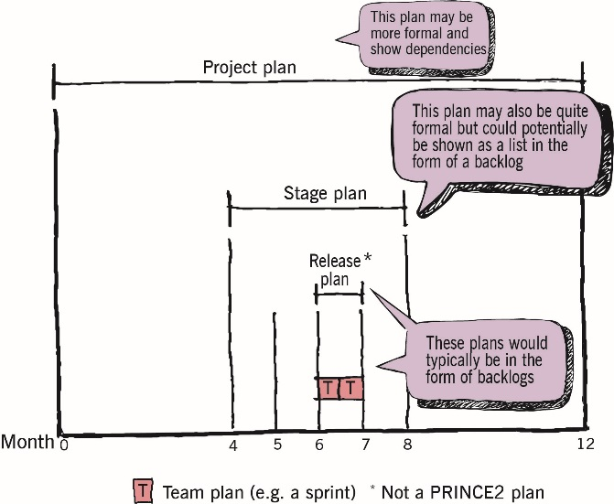
Agile Planning
Based on Axelos PRINCE2 Agile materials. Material is used under license from Axelos Limited. All rights reserved.
PRINCE2 and PRINCE2 Agile are registered trade marks of Axelos Limited, used under permission of Axelos Limited. All rights reserved.
Notes:
In a PRINCE2 Agile environment, formal PRINCE2 approaches to planning may be used at the project level, and perhaps at the stage level.
More informal approaches are likely to be used at the release and sprint levels. In fact, at sprint level, the only planning that might be needed has to do with the timebox backlog, and who will be doing what in this sprint.
The project manager’s job is then to reconcile the plans at each level of the project.

Slide 60
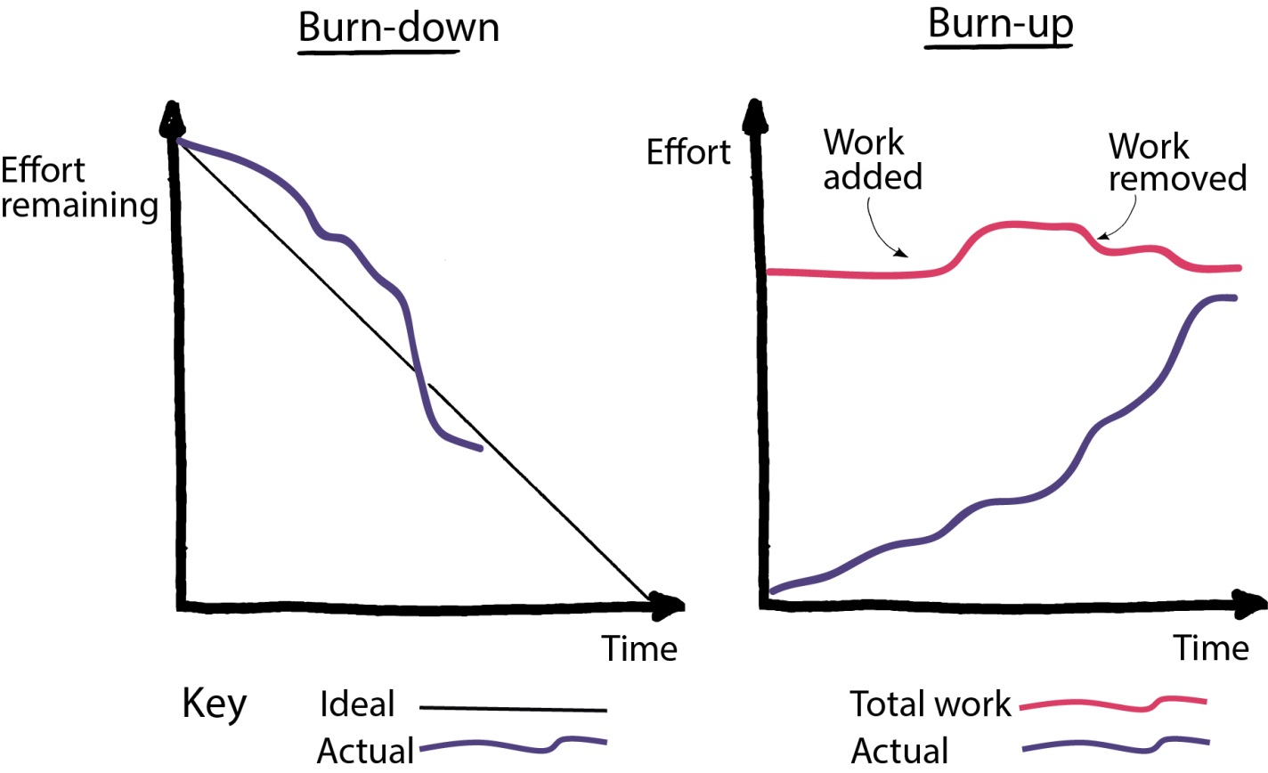
Tracking progress with burn charts
Based on Axelos PRINCE2 Agile materials. Material is used under license from Axelos Limited. All rights reserved.
PRINCE2 and PRINCE2 Agile are registered trade marks of Axelos Limited, used under permission of Axelos Limited. All rights reserved.
Notes:
One of the tools frequently used in agile environments to show progress at the sprint or release level are called burn charts. These charts show time on the horizontal axis, and story points on the vertical axis.
These charts are used to visually show progress, where work that is completed and work still to be do are shown with one or more lines that are updated regularly, or daily.
A burn down chart shows the story points associated with user stories that have not yet met the definition of done. At the start of the sprint, this equals the story points of the user stories brought into the sprint backlog. At the end of a sprint, there should be no user stories that have not reached done. This establishes the expected path. As the development team works through the backlog and gets user stories to done, they will plot the actual path. Differences between the expected and actual paths indicate something that the team needs to address.
A burn up chart has one line that shows the total number of story points associated with all the user stories in the backlog. This can change over the course of the sprint, as user stories are added to or removed from the backlog. This line shows the result expected at the end of the sprint. The other line will show the actual result. It will start off at zero story points completed. As the development team works through the backlog and gets user stories to done, they will plot the actual cumulative story points of all stories that have reached done. The expected and actual result paths should converge at the end of the sprint.

Slide 61
Blending PRINCE2 and agile
PRINCE2 and PRINCE2 Agile are registered trade marks of Axelos Limited, used under permission of Axelos Limited. All rights reserved.

Slide 62
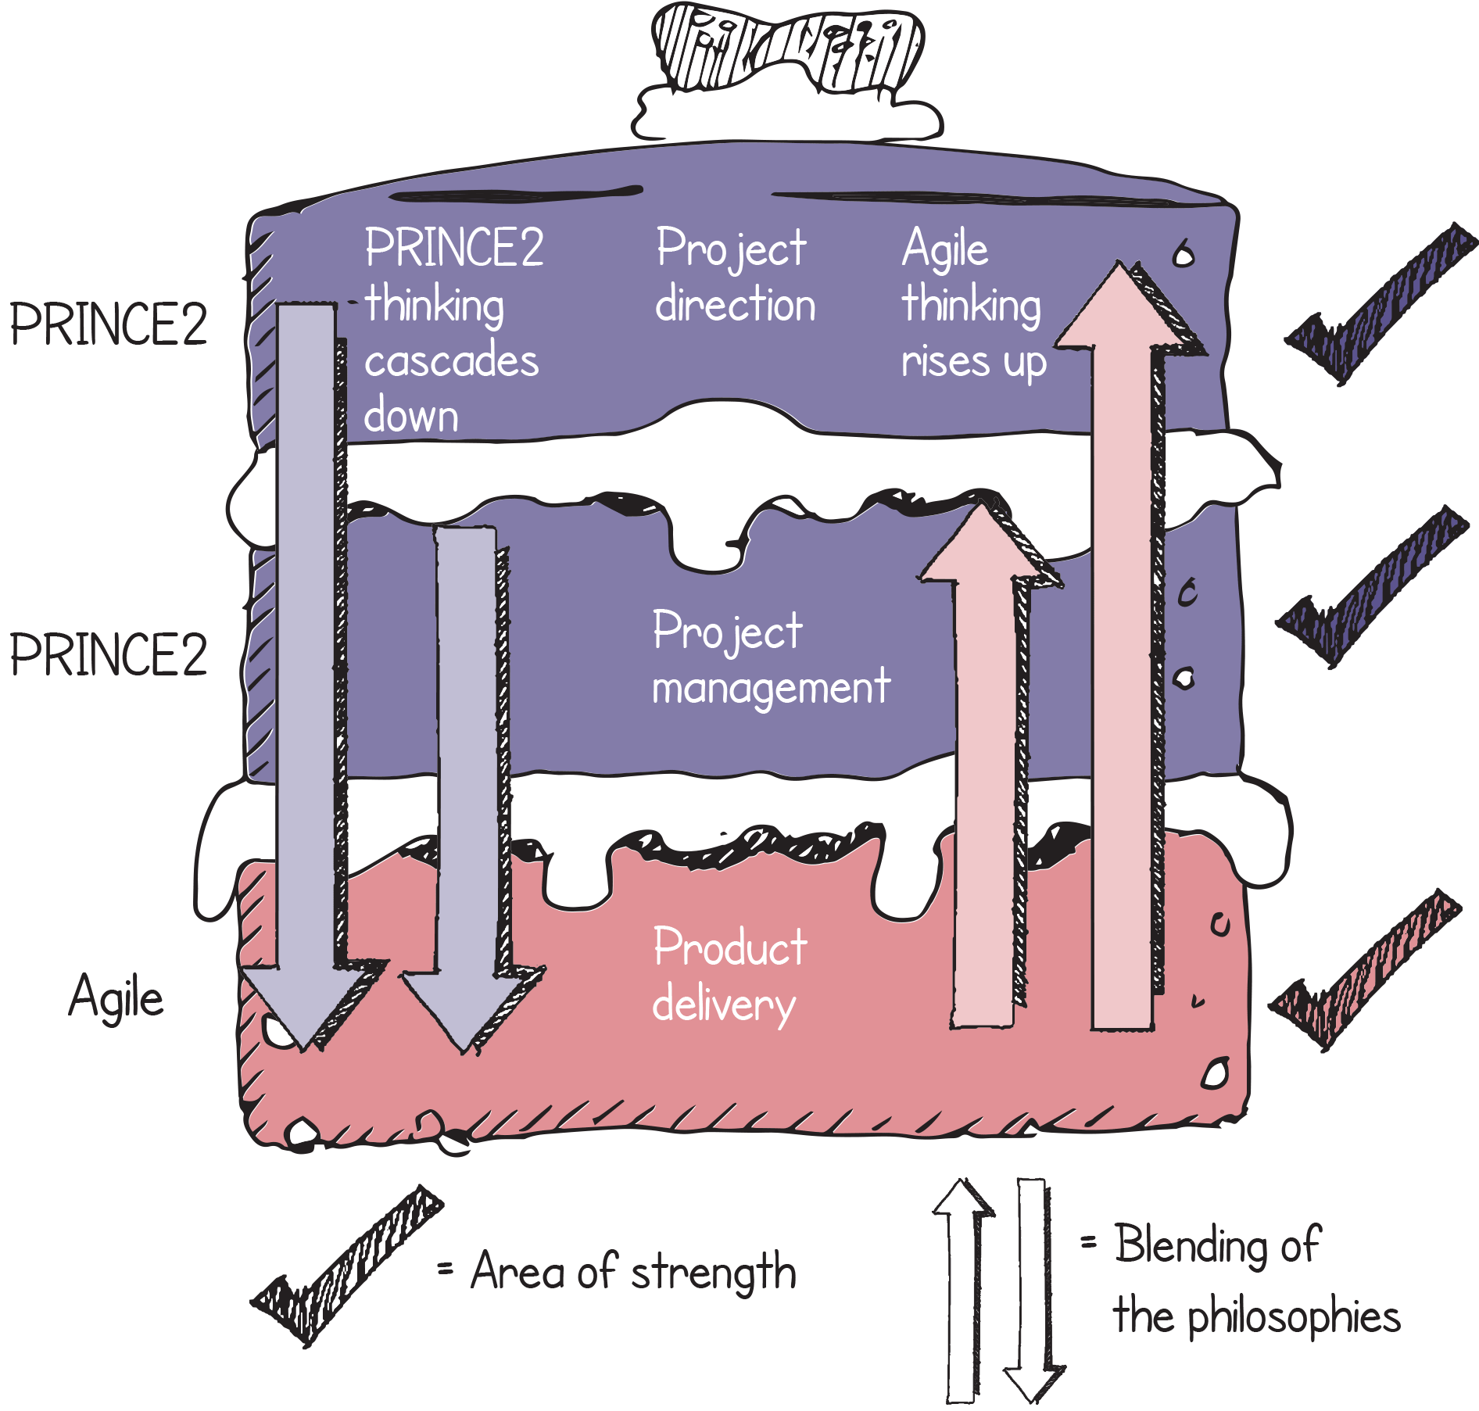
PRINCE2 Agile: blending PRINCE2 and agile together
PRINCE2 and agile each have their own strengths
PRINCE2 focuses on direction and management
Agile is delivery focused
Based on Axelos PRINCE2 Agile materials. Material is used under license from Axelos Limited. All rights reserved.
PRINCE2 and PRINCE2 Agile are registered trade marks of Axelos Limited, used under permission of Axelos Limited. All rights reserved.
Notes:
Those directing and managing must adopt agile disciplines and behaviours.
Those using agile to deliver with a view to the wider project concerns.
This is known as the cake or sometimes the layer cake. It represents the three levels of a project and the important point of the metaphor is that both PRINCE2 and agile have their strengths and we need to play to those strengths. But, we must blend and weave these together as it will not work as well if they are running in parallel universes.
The message to deliver very firmly is about blending and weaving all the ingredients together to create something greater than the sum of the parts.

Slide 63
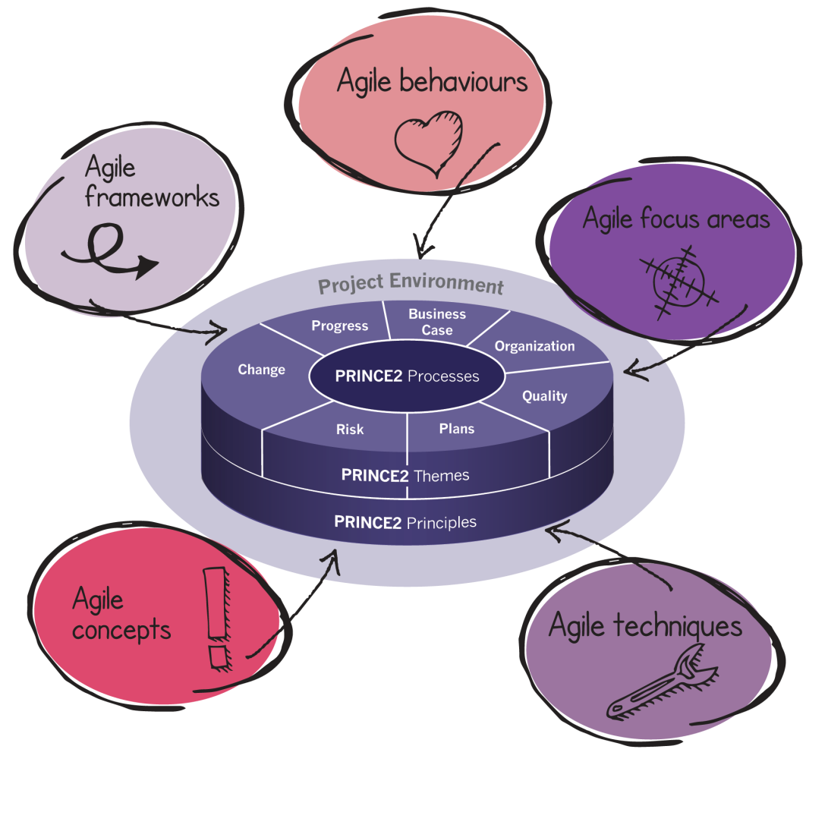
What does PRINCE2 Agile comprise of?
Based on Axelos PRINCE2 Agile materials. Material is used under license from Axelos Limited. All rights reserved.
PRINCE2 and PRINCE2 Agile are registered trade marks of Axelos Limited, used under permission of Axelos Limited. All rights reserved.
Notes:
So what is in PRINCE2 Agile? It is essentially PRINCE2 with tailoring guidance and a few extra bits added on. Nothing is removed from PRINCE2.
The diagram complements the earlier point about PRINCE2 Agile seeing agile as a family of frameworks, concepts, behaviours and techniques along with five focus areas that are in the third section of the manual also included on this diagram.

Slide 64
8 Guidance Points
Based on Axelos PRINCE2 Agile materials. Material is used under license from Axelos Limited. All rights reserved.
PRINCE2 and PRINCE2 Agile are registered trade marks of Axelos Limited, used under permission of Axelos Limited. All rights reserved.
Notes:
An important point when training PRINCE2 Agile is that during the morning of day one (when trying to establish baselines for areas such as what is agile?), it is vital that this table of eight points is understood by all of the delegates. They may not agree with some of the points but the fact is, they are all points upon which PRINCE2 Agile is based. Possibly the most important of all of these eight points is the first one because most people will not realise this.
This (i.e. point 1) could not be said of the previous version of PRINCE2. The second point is also a critical point that all delegates need to understand. PRINCE2 is usually classified (stereotyped?) as ‘a traditional waterfall project management approach’ but that statement (which could be applied to the pre-2009 versions of PRINCE2) cannot be attributed to the current version. The fact that this impression (or prejudice) may still exist needs to be addressed head-on when training PRINCE2 Agile.
All of these points are significant, such as highlighting that agile is more than just scrum, which is a view that will be held by many people. They may even refer to their own method as agile scrum!
Take care with point 8 because although it is true, it is very easy to refer to an ‘agile project’ when talking. If an ‘agile project’ exists then by definition a ‘non-agile project’ exists as well and PRINCE2 Agile is written with a view that agile is a question of how much and not a question of yes or no.
Before leaving this slide it may be a good idea to check that everyone is on board as the 20 slides so far are very much about baselining people’s understanding of the context that PRINCE2 Agile is operating within. The rest of the course is then built on top of this.

Slide 65
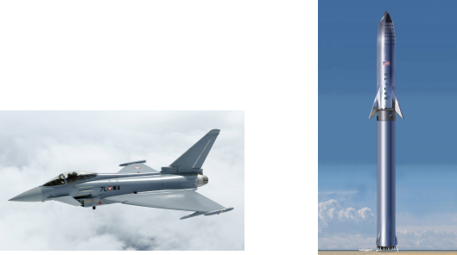
Beware of prejudice!
Control and governance allows agile to be used in complex environments
Copyright © Aspire Australasia Pty Ltd 2021-2022.
Notes:
The Eurofighter Typhoon is a good analogy to use at this point. It is an aeroplane that is inherently unstable through design.
Therefore it can be very agile in a combat situation. The way the analogy works is to highlight that agility does not need to sacrifice governance and control. In fact, it is the opposite. There is more governance and control on the Eurofighter than there is on a jumbo jet for example.

Slide 66
Which agile approach?
Copyright © Aspire Australasia Pty Ltd 2021-2022.

Slide 67
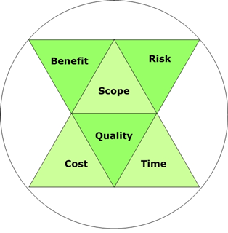
Performance targets and tolerance
PRINCE2 considers 6 aspects of performance
Tolerance is an allowable variation around these targets without the need to raise an exception
In a waterfall project, time and cost are often seen to be the most significant
This is not the case in a project using agile delivery
Based on Axelos PRINCE2 Agile materials. Material is used under license from Axelos Limited. All rights reserved.
PRINCE2 and PRINCE2 Agile are registered trade marks of Axelos Limited, used under permission of Axelos Limited. All rights reserved.
Notes:
Historically, projects have often only considered time / cost / quality as the common variables. PRINCE2 has for a long time extended this to time / cost / quality / scope / risk / benefit. Tolerances have been a way of setting limits for the acceptable variation around the planned expectations of these targets. If a tolerance is forecast to be exceeded, a project goes into exception.
PRINCE2 has in the past described time and cost as the most commonly set tolerances. This makes sense when describing the control needs of a waterfall project. They are where we would expect potential variance and therefore where we want to set our warning triggers.
In a project is using agile, time and cost are fixed and no variance is expected. Any variance here is serious. Allowable variation is around scope and quality.
In simple terms, the previous version of PRINCE2 varies time and cost whereas agile does not. Therefore, you could have said in the past that the 2 were incompatible. However since 2009, with all six aspects now seen as being equal, this allows easy tailoring of PRINCE2 to embrace agile by applying the six aspects, and very importantly their tolerances in an agile-friendly way.

Slide 68
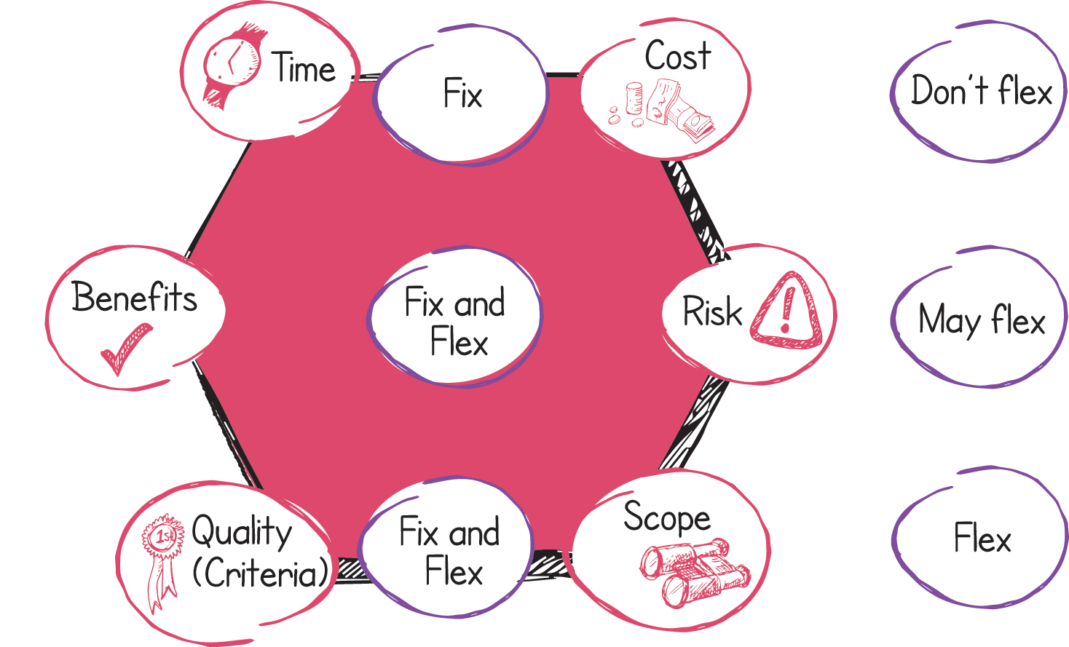
The Hexagon
This is about tolerances and not the aspects themselves
Based on Axelos PRINCE2 Agile materials. Material is used under license from Axelos Limited. All rights reserved.
PRINCE2 and PRINCE2 Agile are registered trade marks of Axelos Limited, used under permission of Axelos Limited. All rights reserved.
Notes:
So fix and flex refers not to the performance targets themselves, but the way that we set tolerance around them.
Agile projects are likely to have stable teams working for agreed timeboxes... This means that there is no opportunity to flex time and cost.
What is flexed (and is a core concept in agile working) is scope and quality.
With regard to quality it is specifically the range between essential and nice to have.
Benefits and risk will be set as is appropriate to the project... They may be flexed, equally they may not be.
Core... Tolerance is used to trigger a discussion with the next level of management above when it becomes likely that the variation in a target would go beyond that which is allowable without discussion and agreement. So we set tolerances to protect against variation leading to unacceptable outcomes.

Slide 69
Tolerance guidance
Aspect | Tolerance guidance | Summary
Time | Zero tolerance for extra time at all levels of plan | Fix
Cost | Zero tolerance for extra cost at all levels of plan | Fix
Scope | Not all aspects of scope are of equal importance, so they can be prioritised. Zero tolerance for mandatory aspects, wider tolerance for less essential aspects | Fix and flex
Quality | Not all aspects of quality are of equal importance, so they can be prioritised. Zero tolerance for mandatory aspects, wider tolerance for less essential aspects ProjectPD: Customer quality expectations, acceptance criteria ProjectDescription: Quality criteria | Fix and flex
Risk | Tolerance must be defined by the Project Board, to suit their needs and the nature of the project | Fix or flex
Benefit | Zero tolerance for the benefits level associated with ‘minimum viability’ in the Business Case, wider tolerance as necessary for other benefits | Fix and flex
Based on Axelos PRINCE2 Agile materials. Material is used under license from Axelos Limited. All rights reserved.
PRINCE2 and PRINCE2 Agile are registered trade marks of Axelos Limited, used under permission of Axelos Limited. All rights reserved.
Notes:
Supports discussion on tolerances. It may be better to omit the slide and instead, reference the table in the manual.

Slide 70
The 5 targets
The 5 targets represent the rationale behind the hexagon and the concept of fix and flex.
Be on time and hit deadlines
Protect the level of quality
Embrace change
Keep teams stable
Accept that the customer does not need everything
Based on Axelos PRINCE2 Agile materials. Material is used under license from Axelos Limited. All rights reserved.
PRINCE2 and PRINCE2 Agile are registered trade marks of Axelos Limited, used under permission of Axelos Limited. All rights reserved.
Notes:
The word ‘target’ may seem an odd choice of word but it has been chosen because this is what you are trying to achieve. All five targets are either highly desirable or sensible concepts. If the delegates can understand the rationale behind every target, they then understand why the PRINCE2 Agile hexagon is like it is.
This detailed rationale is so important for the delegates to understand and it is detailed in each of the five following slides.
The five targets can be trained in various ways but one option is to use a flipchart and draw out from the delegates the advantages of the five targets. If the training is done this way the sequence should be to ask the delegates about the advantages of being on time. Then describing why teams should be kept stable. Then draw out the advantages from the delegates of responding to change. Back this point by describing why the customer doesn’t need everything…. And then finally the missing piece in the jigsaw is to explain that working this way can ultimately protect quality. When drawing out from the delegates views on protecting quality, it is worth asking the question ‘what do people do that compromises quality?’ The usual responses are statements like reduced testing, reduce the documentation, etc.

Slide 71
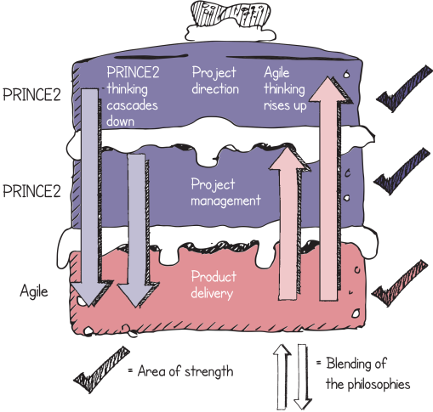
Be on time and hit deadlines
Why?
Early realisation of benefits
Helps with planning
Gives confidence
There may be no choice
Reduce the likelihood of cost overruns
Improves reputation
Based on Axelos PRINCE2 Agile materials. Material is used under license from Axelos Limited. All rights reserved.
PRINCE2 and PRINCE2 Agile are registered trade marks of Axelos Limited, used under permission of Axelos Limited. All rights reserved.
Notes:
It is vital for the trainer to get across that this point is massive. The reasons outlined on the slide are not minor benefits, they are hugely significant in a project context.
Time is one of the most powerful weapons in agile.

Slide 72
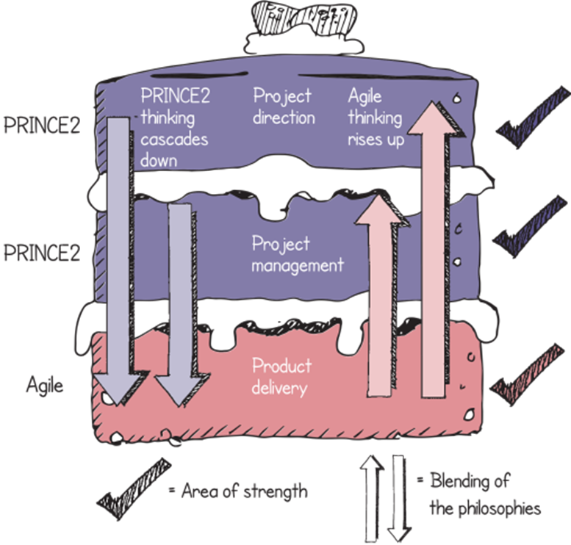
Embrace change
Why?
It is inevitable
A more accurate final product is more likely
Can be handled by flexing what is delivered
Based on Axelos PRINCE2 Agile materials. Material is used under license from Axelos Limited. All rights reserved.
PRINCE2 and PRINCE2 Agile are registered trade marks of Axelos Limited, used under permission of Axelos Limited. All rights reserved.
Notes:
Perhaps ask the delegates if this is likely to happen and why does it happen. Remember there are two types of change: big changes to the overall scope or refinement of the detail...
Setting a tolerance on scope and quality allows us to define the line between these two types of change.

Slide 73
Protect the level of Quality
Why?
To ensure that the appropriate level of quality is achieved
And therefore the desired outcomes are possible
Damaging effects result from:
Reduced testing
Incomplete documentation
Sub-optimal design
Lack of appropriate training
Non-compliance to standards
Based on Axelos PRINCE2 Agile materials. Material is used under license from Axelos Limited. All rights reserved.
PRINCE2 and PRINCE2 Agile are registered trade marks of Axelos Limited, used under permission of Axelos Limited. All rights reserved.
Notes:
P2 talks about fit for purpose... A level of quality that enables the desired outcomes to be achieved.
The consequence of poor quality is an increased TCO (total cost of ownership). Poor design, and its impact, is an area that can be worth facilitating a discussion about with the delegates.
Key to this is the way that we ultimately protect quality... We do less (we reduce function and feature) but maintain quality standards.

Slide 74
KEEP THE TEAMS STABLE
Why?
Agile favours self organising teams and informal communication
Changing team members (in the short term) can have a detrimental effect:
Time spent bringing new team members up to speed
Number of communication lines in the team grows exponentially
An opportunity cost incurred to the areas providing the new people
The team dynamics change and need to be re-established.
Based on Axelos PRINCE2 Agile materials. Material is used under license from Axelos Limited. All rights reserved.
PRINCE2 and PRINCE2 Agile are registered trade marks of Axelos Limited, used under permission of Axelos Limited. All rights reserved.
Notes:
Most people will mention the impact of the learning curve on changing team members during a timebox but most people do not realise that it is the effect on team dynamics that can, but not always, be the most damaging.
It is worth pointing out that over longer term periods then team personnel may change. This target refers to short-term timescales and the point that adding people to a Timebox or Sprint is not a clever option with respect to agile.

Slide 75
Accept that the customer doesn’t need everything
Why?
If compromise is necessary, PRINCE2 Agile believes that the safest way to do this is by varying the features of a product
This is because:
Usually, not everything defined at the start must be delivered
Many functions and features are rarely, or never used
This helps when trying to hit deadlines and protect the level of quality
Delivers what the customer really wants more quickly.
Based on Axelos PRINCE2 Agile materials. Material is used under license from Axelos Limited. All rights reserved.
PRINCE2 and PRINCE2 Agile are registered trade marks of Axelos Limited, used under permission of Axelos Limited. All rights reserved.
Notes:
Key to this prioritisation is the use of approaches like MoSCoW... Good place to mention for the first time
This is reviewed in more detail in the requirements section
Speaker Notes:
We never set out to do less than planned and requested. But when we fall behind and things prove more difficult than we hoped, then we need to deal with challenges that this sets for us. If we are to meet deadlines and protect the level of quality, the safest way to do this is to reduce the amount of work that we do... To build less.
There are many examples of where many features are not used such as with an iPhone, or use the example in the manual of a washing machine: most people use two programs or less.

Slide 76
PART 2 Tailoring PRINCE2 FOR USE WITH AGILE WAYS OF WORKING
PRINCE2 and PRINCE2 Agile are registered trade marks of Axelos Limited, used under permission of Axelos Limited. All rights reserved.

Slide 77
Agile behaviours and PRINCE2’s principles
PRINCE2 and PRINCE2 Agile are registered trade marks of Axelos Limited, used under permission of Axelos Limited. All rights reserved.

Slide 78
Applying PRINCE2 principles
Continued business justification | Agile value and MVP
Learn from experience | Retrospectives, short feedback loops and “inspect and adapt”
Defined roles and responsibilities | Blending PRINCE2 roles and additional agile roles
Manage by stages | Timeboxes, e.g. releases and sprints, shorter stages to support innovation
Manage by exception | Tolerances empower people
Focus on products | Prioritisation of products and quality criteria
Tailor to suit the project | Agile assessments with the Agilometer
Based on Axelos PRINCE2 Agile materials. Material is used under license from Axelos Limited. All rights reserved.
PRINCE2 and PRINCE2 Agile are registered trade marks of Axelos Limited, used under permission of Axelos Limited. All rights reserved.
Notes:
PRINCE2 principles do not conflict with any of the agile principles. They are complimentary to the agile way of working
We are looking at table 7.1 here to gain an understanding of what agile might talk about in the vein of P2 principles

Slide 79
PRINCE2 Agile behaviours
Transparency | Openness and visibility but also honesty, trust, integrity and respect
Collaboration | Internal (the team work together) and external (engaging with customers) leading to shared understanding and ownership
Rich communication | Face to face in preference to words alone
Self-organisation | Trust the people closest to the work to know best
Exploration | Frequent iterations and rapid feedback loops provide an opportunity to learn (experiments and spikes)
Based on Axelos PRINCE2 Agile materials. Material is used under license from Axelos Limited. All rights reserved.
PRINCE2 and PRINCE2 Agile are registered trade marks of Axelos Limited, used under permission of Axelos Limited. All rights reserved.
Notes:
See glossary for spike definition
There are many things that we could have spoken about in this section but these are the behaviours that have been identified by the author that need to function smoothly for agile to operate in the most effective way.
All of these will be seen again later in the manual.

Slide 80
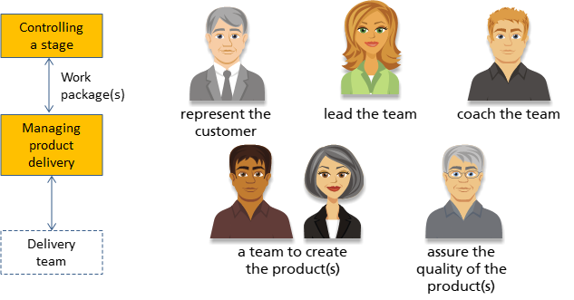
Generic agile team structure
Based on Axelos PRINCE2 Agile materials. Material is used under license from Axelos Limited. All rights reserved.
PRINCE2 and PRINCE2 Agile are registered trade marks of Axelos Limited, used under permission of Axelos Limited. All rights reserved.
Notes:
Many agile frameworks introduce a few roles. We’ve previously seen the 3 roles associated with Scrum.
Here we’ve identified some generic roles that might be useful in an agile environment:
Someone to ‘lead’ the team, although in an agile environment this must be interpreted carefully. For example, the ‘team leader’ may just be the person who is coordinating the daily scrum today, or who liaises with the project manager in this sprint;
Someone to represent the customer’s interests;
A team of people who will develop the products;
Someone to assure the quality of the products created by the team. This role could be taken by a team member who was not involved in the development of the products being assured.; and finally
Someone to coach the team in various aspects of the agile frameworks, techniques and behaviours that they may not yet be familiar with.
In a PRINCE2 environment, work is delegated by the project manager in the Controlling a Stage process, as a ‘work package’. The work package is accepted by the team in the Managing Product Delivery process. A ‘work package’ may consist of a ‘release backlog’ associated with the current stage, as well as some controls or other guidance that the team need to understand. Otherwise, PRINCE2 would say that the way the team performs their work is entirely a matter for the team.

Slide 81
Agile and PRINCE2’s themes
PRINCE2 and PRINCE2 Agile are registered trade marks of Axelos Limited, used under permission of Axelos Limited. All rights reserved.

Slide 82
Tailoring the business case theme
No changes required
More information on tolerances around benefits
Best case, worst case, expected case
Linking amount of product to benefit accrued
Explicit definition of what constitutes the minimum viable product (MVP)
Implications of incremental delivery
Early benefit and early costs
Where there is high uncertainty develop the business case quickly
Plan to test assumptions quickly
Based on Axelos PRINCE2 Agile materials. Material is used under license from Axelos Limited. All rights reserved.
PRINCE2 and PRINCE2 Agile are registered trade marks of Axelos Limited, used under permission of Axelos Limited. All rights reserved.
Notes:
Because we are basing P2A on flexing what is delivered, we need to see the potential impacts of varying amounts of product laid out in the business case.
Explain benefit and value.
P2 tends to describe the benefit realized by the project, this may be incremental. Agile tends to describe the value accrued from a story and uses this to prioritise the stories.
See glossary for useful definitions.

Slide 83
Tailoring the organization theme
No changes required but additional delivery roles may be needed
Consideration needs to be given to:
The team manager role
How it might be integrated into the delivery team
Common agile roles
E.g. product owner, scrum master, agile coach, business ambassador
The senior user role
Acting as a super product owner
The scrum master
Liaison with the project manager
Management by exception to enable self-organization
Based on Axelos PRINCE2 Agile materials. Material is used under license from Axelos Limited. All rights reserved.
PRINCE2 and PRINCE2 Agile are registered trade marks of Axelos Limited, used under permission of Axelos Limited. All rights reserved.
Notes:
The foundation syllabus does not explicitly test the additional roles suggested by P2A. However, it might be worth a brief mention here.
As the project gets larger the care with which the roles and responsibilities need to be combined will increase... Multiple interests, multiple stakeholders will need to be engaged and coordinated.

Slide 84
The three PRINCE2 project interests
Based on Axelos PRINCE2 Agile materials. Material is used under license from Axelos Limited. All rights reserved.
PRINCE2 and PRINCE2 Agile are registered trade marks of Axelos Limited, used under permission of Axelos Limited. All rights reserved.
Notes:
Important to check that everyone understands P2’s view of the world
The customer supplier environment
The roles are developed to represent this perspective

Slide 85
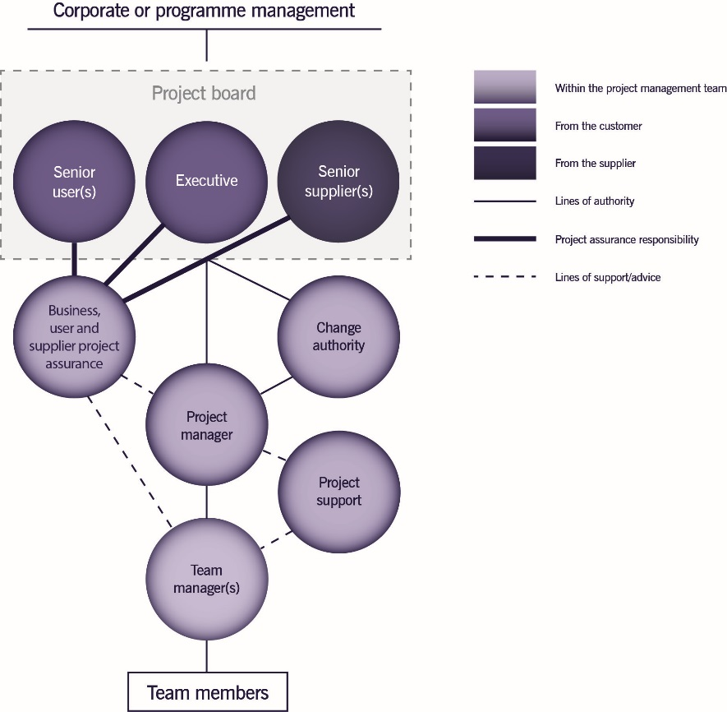
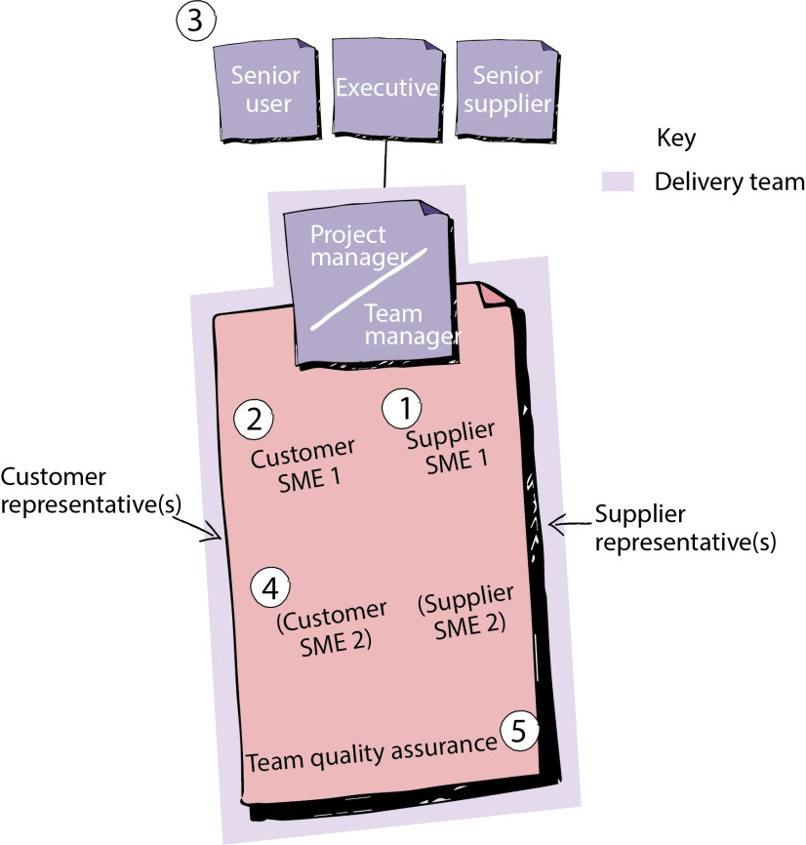
Tailoring the organization theme: Roles
Working agreements can help to document roles and responsibilities
Based on Axelos PRINCE2 Agile materials. Material is used under license from Axelos Limited. All rights reserved.
PRINCE2 and PRINCE2 Agile are registered trade marks of Axelos Limited, used under permission of Axelos Limited. All rights reserved.
Notes:
The foundation requires that we understand the responsibilities of the key PRINCE2 and agile roles.
These are found in appendix B.1 and B.2.
It also explicitly tests an understanding of working agreements.
Above we have the classic PRINCE2 project management team structure.
And the PRINCE2 Agile set-up for a single team.
Start with the PRINCE2 Roles and then discuss the need for the newer roles.
Link the roles to more familiar agile roles such as product owner and scrum master.

Slide 86
Customer subject matter experts (SMES)
Based on Axelos PRINCE2 Agile materials. Material is used under license from Axelos Limited. All rights reserved.
PRINCE2 and PRINCE2 Agile are registered trade marks of Axelos Limited, used under permission of Axelos Limited. All rights reserved.

Slide 87
Customer representatives (Specialists)
Based on Axelos PRINCE2 Agile materials. Material is used under license from Axelos Limited. All rights reserved.
PRINCE2 and PRINCE2 Agile are registered trade marks of Axelos Limited, used under permission of Axelos Limited. All rights reserved.

Slide 88
Supplier smes
Based on Axelos PRINCE2 Agile materials. Material is used under license from Axelos Limited. All rights reserved.
PRINCE2 and PRINCE2 Agile are registered trade marks of Axelos Limited, used under permission of Axelos Limited. All rights reserved.

Slide 89
Supplier Representatives(specialists)
Based on Axelos PRINCE2 Agile materials. Material is used under license from Axelos Limited. All rights reserved.
PRINCE2 and PRINCE2 Agile are registered trade marks of Axelos Limited, used under permission of Axelos Limited. All rights reserved.

Slide 90
Delivery team quality assurance
Based on Axelos PRINCE2 Agile materials. Material is used under license from Axelos Limited. All rights reserved.
PRINCE2 and PRINCE2 Agile are registered trade marks of Axelos Limited, used under permission of Axelos Limited. All rights reserved.

Slide 91
Tailoring the quality theme
Ensure that stakeholders appreciate the difference between scope and quality.
A reduction in scope is not a reduction in quality
Protect the fitness of purpose of products by:
Prioritising acceptance criteria and quality criteria
Defining quality tolerances
Differentiating between functional and non functional requirements
Use agile concepts to help clarify quality criteria
Definitions of Ready and Done
Consider the frequency of quality checking and the impact on the way that the project is planned and runs
Based on Axelos PRINCE2 Agile materials. Material is used under license from Axelos Limited. All rights reserved.
PRINCE2 and PRINCE2 Agile are registered trade marks of Axelos Limited, used under permission of Axelos Limited. All rights reserved.
Notes:
Discuss the significance of product descriptions to this theme (in particularly the PPD).
They can be formal or informal, they can evolve and as we will see later in requirements, they may be the same (or at least fulfil a similar purpose to that of a user story).
Testing is key to many agile delivery frameworks... How we are going to do this should be defined in the quality management approach (quality planning)
It will be implemented during delivery (quality control) together with demos and sprint reviews.
Agile likes test first and test driven development... Quality planning will consider how much of this we can do in the project.

Slide 92
Tailoring the plans theme
No changes required but many agile techniques and approaches exist in this area
Often informal and low tech e.g. sprint planning, simple list of backlog
Agile typically looks at how much (or how much value) can be delivered in a fixed time frame
Releases, sprints, burn charts
Gantt charts and formal milestones that show how long a fixed amount of work will take may be relevant to higher levels of plan
High level plans and low level backlogs need to be synchronized
Based on Axelos PRINCE2 Agile materials. Material is used under license from Axelos Limited. All rights reserved.
PRINCE2 and PRINCE2 Agile are registered trade marks of Axelos Limited, used under permission of Axelos Limited. All rights reserved.
Notes:
PRINCE2 is happy to support any type of planning... Gantt charts or backlog list.
PRINCE2 thinks of plans as delivering control and communication... This might mean that we want to represent our information in different ways for different stakeholders.
High level plans traditional in structure and format
Low level plans simple and practical
In between plans (stage) variable depending upon the size and complexity of the project.
P2s product based planning works especially well with agile

Slide 93
Tailoring the risk theme
Agile techniques address many of the familiar risks on projects
Avoiding too much detail at the start, daily stand-ups, frequent delivery of product, frequent demos, customer interaction and self-managed teams
However, agile working has its own set of potential risks
E.g. the challenges of continual customer engagement
Processes that support risk management do not need to be bureaucratic; the level of formality should be appropriate to the needs of the project
E.g. a few columns on the team board vs an electronic risk register
Based on Axelos PRINCE2 Agile materials. Material is used under license from Axelos Limited. All rights reserved.
PRINCE2 and PRINCE2 Agile are registered trade marks of Axelos Limited, used under permission of Axelos Limited. All rights reserved.
Notes:
PRINCE2 is great at planning for risk.
Agile tends to try and run in a way that reduces risk and then deal with things as they happen.
Be careful of the distinction between a risk that may happen but has not happened yet and an issue that has happened and requires management action.

Slide 94
Tailoring the change theme
Both PRINCE2 and agile see change as inevitable
The combination of both views
Control significant change
The level where the project was justified
Enable responsive change at the detail level
The level where change improves the quality and usability product
Product descriptions (quality criteria and tolerance) and work packages need to enable
Clear baselines that can be managed formally (escalated to the project board or to a change authority)
Detail level change within defined tolerances that can be managed by the team dynamically
Based on Axelos PRINCE2 Agile materials. Material is used under license from Axelos Limited. All rights reserved.
PRINCE2 and PRINCE2 Agile are registered trade marks of Axelos Limited, used under permission of Axelos Limited. All rights reserved.
Notes:
This is a real win-win.
PRINCE2 governance (direction and management) handles the big changes to the project product description and major products that would change the basis of the project approval and justification.
Agile working practices welcome change, handle it quickly and simply, through prioritisation and trading of features in a backlog or list.

Slide 95
Tailoring the progress theme
No changes required but many agile techniques and approaches exist in this area
Agile focus on tracking what is delivered, e.g. velocity, lead times or value
Tolerances would be set to support this (scope and quality)
Within the... sprint burn down and burn up charts
Across releases... demonstrating value accrued
Progress is tracked at all levels of the project and both agile techniques and PRINCE2 processes have value
Based on Axelos PRINCE2 Agile materials. Material is used under license from Axelos Limited. All rights reserved.
PRINCE2 and PRINCE2 Agile are registered trade marks of Axelos Limited, used under permission of Axelos Limited. All rights reserved.
Notes:
Agile sees what is delivered as the primary measure of performance... Therefore burn charts are great for every level of the project.
Track completed products rather than days spent.
Agile also favours tracking performance and then using this to look ahead and predict future delivery (velocity). It is natural for the project manager to want to develop plans, however it might take some work before a clear picture emerges (several sprints).
Early planning might include the first identification of stages and second within those appropriate releases and within that sprints.

Slide 96
Agile and PRINCE2’s processes
PRINCE2 and PRINCE2 Agile are registered trade marks of Axelos Limited, used under permission of Axelos Limited. All rights reserved.

Slide 97
Agile and the PRINCE2 Processes
Agile needs to be incorporated into all 7 processes
The amount of agile that is appropriate to each process does vary
Based on Axelos PRINCE2 Agile materials. Material is used under license from Axelos Limited. All rights reserved.
PRINCE2 and PRINCE2 Agile are registered trade marks of Axelos Limited, used under permission of Axelos Limited. All rights reserved.
Notes:
These diagrams show where agile fits into the PRINCE2 process model. The overall PRINCE2 process model doesn’t really change at the higher level because the action from a process point of view with respect to agile takes place at the product delivery level.
Again the diagram shows a way that a stage may be broken down. It should be pointed out that there are a variety of agile approaches and maybe only one release takes place per stage or potentially hundreds! What is being shown is a typical configuration. Also remember that sprints may not be being used it could be more flow-based as per Kanban.

Slide 98
Relating agile processes to PRINCE2 processes
Based on Axelos PRINCE2 Agile materials. Material is used under license from Axelos Limited. All rights reserved.
PRINCE2 and PRINCE2 Agile are registered trade marks of Axelos Limited, used under permission of Axelos Limited. All rights reserved.
Notes:
P2 stages, containing Releases, containing Sprints. All different timeboxes
This diagram then relates how the typical agile process fits in to PRINCE2.
Please note this is how it fits into PRINCE2 and not PRINCE2 Agile .
Understanding this distinction is important because PRINCE2 Agile is not a new method or new framework, it is guidance on how to tailor PRINCE2 to work in an agile context.
Both of these diagrams are more mature than the basic backlog and Sprint view of agile. The bottom diagram could be said to be more mature than the top diagram as it supports the concept of releases which are typically larger container time boxes.
You could ask the delegates which of these two they see more often, but when you hear words like vision and product roadmap in an agile context, this is more advanced than a simple backlog and Sprint situation. It is important to point out that in the scrum guide the idea of vision and release backlogs do not exist.

Slide 99
Tailoring starting up a project and initiating a project
Viable and worthwhile / Solid foundations to understand the work
Define things at the right level
Project Product Description (Outputs, Outcomes)
Business case (Best / worst amount of product and Benefits)
High level requirements (epics)
Define things in the right way
To enable agile to work easier, e.g. outcome focussed
Set up the project in an appropriate manner
Integrating with agile teams, e.g. role names
Impact of frequent releases of products to enable and provide benefits
PRINCE2 and PRINCE2 Agile are registered trade marks of Axelos Limited, used under permission of Axelos Limited. All rights reserved.
Notes:
Section 17.3
Agile tends to get straight to work, PRINCE2 likes to plan and then decide.
We need to keep the best of both... Some justification, some clarity of output/outcome, reviewing agile suitability and if appropriate then preparing the project for agile working.
But not taking too long and in the case of very uncertain projects moving on to delivery, experimentation and “inspect and adapt” more quickly.

Slide 100
Tailoring the early management products
Project brief | Likely to be informal. Project definition more outcome based. Impact of frequent delivery considered. Lean startup and MVP. Includes the project approach that will discuss the use and benefit of agile working.
Business case | Impact of flexing amount delivered considered. MVP identified. Best case / worst case described in terms of amount delivered.
Project product description | Focus on outcome desired. Created as part of a workshop. Composition (major products) might be similar to epics. Creation of the product backlog.
Project initiation documentation (set) | Enough and no more. May exist as an information radiator. Plan the frequency of releases. Write a definition of done. Map PRINCE2 and agile roles. Describe the tailoring undertaken.
PRINCE2 and PRINCE2 Agile are registered trade marks of Axelos Limited, used under permission of Axelos Limited. All rights reserved.
Notes:
Business Case... If the MVP is forecast to be delivered later than expected then this would cause an exception.
Project Product Description... The output still needs to be clear and precise to ensure that the project does not go off track.
During this section on processes we will also review the purpose and guidance of the key management products.
Section 17.3 and tables 23.1, 23.2, 23.3 these sections are examinable in the foundation.

Slide 101
Tailoring controlling a stage and managing product delivery processes
Stages made up of timeboxes
Releases and sprints, features to enable benefits
Team-based collaboration
Planning, estimating, flexible work packages
Reporting and communication, issues and risks
Stand-ups, information radiators, burn charts, sprint demos
Blockers and impediments, agile assessment guides risk management
Control focusses on what is being delivered
Scope and Quality criteria
PRINCE2 and PRINCE2 Agile are registered trade marks of Axelos Limited, used under permission of Axelos Limited. All rights reserved.
Notes:
Syllabus area
Learning outcome 5
Assessment Criteria 5.5 /5.6
Speaker notes:
The crafting and use of work packages is very significant in PRINCE2 Agile it could be said they are THE interface. There are many mechanisms in a work package that can help with agile such as tolerances.

Slide 102
Tailoring the stage management products
Work package | A vital interface. Brings PRINCE2 and agile working together. Collaboratively defined. A clear safe boundary of control. Also space to empower teams to self-organise and enable rich communication. May include one or more releases or sprints.
Highlight report | Important yet likely to be informal. Contains information on releases and sprints and benefits enabled. Could be in the form of an information radiator and/or burn chart.
Checkpoint report | Could be replaced by the daily stand-up but must not change the stand-up to “reporting to...”. Could be in the form of an information radiator and/or burn chart.
PRINCE2 and PRINCE2 Agile are registered trade marks of Axelos Limited, used under permission of Axelos Limited. All rights reserved.

Slide 103
Tailoring managing a stage boundary process
Look Back
How did we do?
How much delivered?
What quality?
Benefit delivered?
Process working well?
Release reviews and retrospectives?
Look Forward
Plan the next stage, releases and sprints
Review product and release backlogs
Release planning
Look at the big picture
Review the business case
Review the project plan
Review the performance of agile
Decide whether to continue?
PRINCE2 and PRINCE2 Agile are registered trade marks of Axelos Limited, used under permission of Axelos Limited. All rights reserved.
Notes:
Assessing progress will be represented in the form of what has been delivered as opposed to when, and how much time has been spent in the Timebox.
This may be a good time to assess how agile is progressing on the project.

Slide 104
Tailoring closing a project process
Look Back
How did we do?
How much was delivered? What quality?
Benefit delivered? Process working well?
Final project / release reviews and retrospectives?
Look Forward
How many more benefits can we expect?
When will we get them?
Look at the big picture
Check the original baselines against final outputs and outcomes
Check products accepted
Final operational handovers
Documentation finalized
PRINCE2 and PRINCE2 Agile are registered trade marks of Axelos Limited, used under permission of Axelos Limited. All rights reserved.
Notes:
This is not such a big thing... We have completed many deliveries, gained many sign-offs and delivered much value during the project.
This can simply be seen as the last of a series.
It is however an important time to take stock and compare original promises with final delivery.
It is also the time to evaluate agile working practices.

Slide 105
Tailoring directing a project
Manage by Exception to empower teams
Progress reporting... amount delivered and benefits realised
The project board attends key demos to gain insight into the details of the project
Decision making may be based upon information pulled from radiators
PRINCE2 and PRINCE2 Agile are registered trade marks of Axelos Limited, used under permission of Axelos Limited. All rights reserved.
Notes:
Syllabus area
Learning Outcome 5
Assessment Criteria 5.6 and 5.7
Speaker notes:
Manage by exception is a very big button to press in terms of the value PRINCE2 can bring to agile. Applied correctly this should create space for people to be empowered and self organise which is in effect creating the very environment that agile so much wishes to promote and create. The easy criticism of PRINCE2 is that it is command and control but the reality is that when PRINCE2 is done well it is based upon trust and empowerment.

Slide 106
PART 3 FOCUS AREAS
PRINCE2 and PRINCE2 Agile are registered trade marks of Axelos Limited, used under permission of Axelos Limited. All rights reserved.

Slide 107
Agilometer
PRINCE2 and PRINCE2 Agile are registered trade marks of Axelos Limited, used under permission of Axelos Limited. All rights reserved.

Slide 108
Agilometer
Uses:
Assess the suitability of the project environment for agile working
Guides how to tailor PRINCE2 in the most effective way
Done pre-project and repeated at stage boundaries
Sliders considered individually and not “added up” or averaged
PRINCE2 and PRINCE2 Agile are registered trade marks of Axelos Limited, used under permission of Axelos Limited. All rights reserved.
Notes:
Put the agilometer in context... It is a tool to help us think through the project environment and then to guide us as to key areas to improve or develop. For agile to succeed we must create an agile friendly environment.

Slide 109
Requirements
PRINCE2 and PRINCE2 Agile are registered trade marks of Axelos Limited, used under permission of Axelos Limited. All rights reserved.
Notes:
The terms requirements, product descriptions and user stories are often used interchangeably.
Functional (what it does)
Non-functional (how well it does it)

Slide 110
Requirements
Top level
Project product description, vision, product groups, epics, features, high-level requirements. Often prioritized using MoSCoW
Lower levels
Product descriptions, requirements, features, user stories
Often prioritized using order
Requirements represent the currency of an agile project
PRINCE2 and PRINCE2 Agile are registered trade marks of Axelos Limited, used under permission of Axelos Limited. All rights reserved.
Notes:
Requirements are prioritised at the highest level using MoSCoW. To group and identify dependencies.
They are prioritised at the lowest level in a simple forced list to ensure that relative value is clear.

Slide 111
Requirements - granularity
PRINCE2 and PRINCE2 Agile are registered trade marks of Axelos Limited, used under permission of Axelos Limited. All rights reserved.

Slide 112
Rich communication
PRINCE2 and PRINCE2 Agile are registered trade marks of Axelos Limited, used under permission of Axelos Limited. All rights reserved.
Notes:
Agile needs fast and clear communications... That is why it favours face to face... An agile working environment is about efficient and effective working without delays.
PRINCE2 favours clear shared understanding... In the past that has led to documentation and reports... But it does not have to be done to a degree that is detrimental to the delivery.

Slide 113
Big visual charts
Copyright © Aspire Australasia Pty Ltd 2021-2022.

Slide 114
Workshops
PRINCE2 and PRINCE2 Agile are registered trade marks of Axelos Limited, used under permission of Axelos Limited. All rights reserved.

Slide 115
facilitation
PRINCE2 and PRINCE2 Agile are registered trade marks of Axelos Limited, used under permission of Axelos Limited. All rights reserved.

Slide 116
Frequent releases
PRINCE2 and PRINCE2 Agile are registered trade marks of Axelos Limited, used under permission of Axelos Limited. All rights reserved.
Notes:
If the real value in agile is behaviours and attitudes... Perhaps the most obvious physical attribute is little and often, frequent releases.

Slide 117
Frequent releases
PRINCE2 and PRINCE2 Agile are registered trade marks of Axelos Limited, used under permission of Axelos Limited. All rights reserved.
Notes:
These are tangible advantages, and have real value in selling agile working to our customers.

Slide 118
Agile contracts
Copyright © Aspire Australasia Pty Ltd 2021-2022.

Slide 119
Structuring an Agile contract
PRINCE2 and PRINCE2 Agile are registered trade marks of Axelos Limited, used under permission of Axelos Limited. All rights reserved.

Slide 120
END OF Course
PRINCE2 and PRINCE2 Agile are registered trade marks of Axelos Limited, used under permission of Axelos Limited. All rights reserved.

Slide 121
Course Objectives
Understand the key aspects of PRINCE2
Understand the basic concepts behind common agile ways of working
Demonstrate the purpose of combining PRINCE2 with agile ways of working
Be able to fix and flex the six aspects of a project in an agile context
Apply the PRINCE2 principles and tailor the themes, processes and management products to a project in an agile context
Incorporate the focus areas that can support a PRINCE2 Agile implementation
Prepare for the PRINCE2 Agile Foundation Exam
PRINCE2 and PRINCE2 Agile are registered trade marks of Axelos Limited, used under permission of Axelos Limited. All rights reserved.

Slide 122
Contact AXELOS
Web: AXELOS.com
Twitter: @AXELOS_GBP
G+: AXELOS
LinkedIn: AXELOS Global Best Practice
YouTube: AXELOS
PRINCE2 and PRINCE2 Agile are registered trade marks of Axelos Limited, used under permission of Axelos Limited. All rights reserved.
Notes:
One agile concept is that of continuous improvement and seeking feedback.
Encourage any delegates to engage with PRINCE2 Agile and feedback to AXELOS if they have any comments both positive or negative.

